Slide 1
Moneris Cloud User Manual
By Syncoria– A Silver Partner of Odoo

Slide 2
Content
Moneris Cloud System Flow
System Configuration
POS Payment Method Configuration
Point of Sale Configuration
Invoice Configurations for Moneris Cloud
Payment Flow in Odoo Invoice
Payment Flow in Odoo POS

Slide 3
Moneris Cloud System Flow

Slide 4
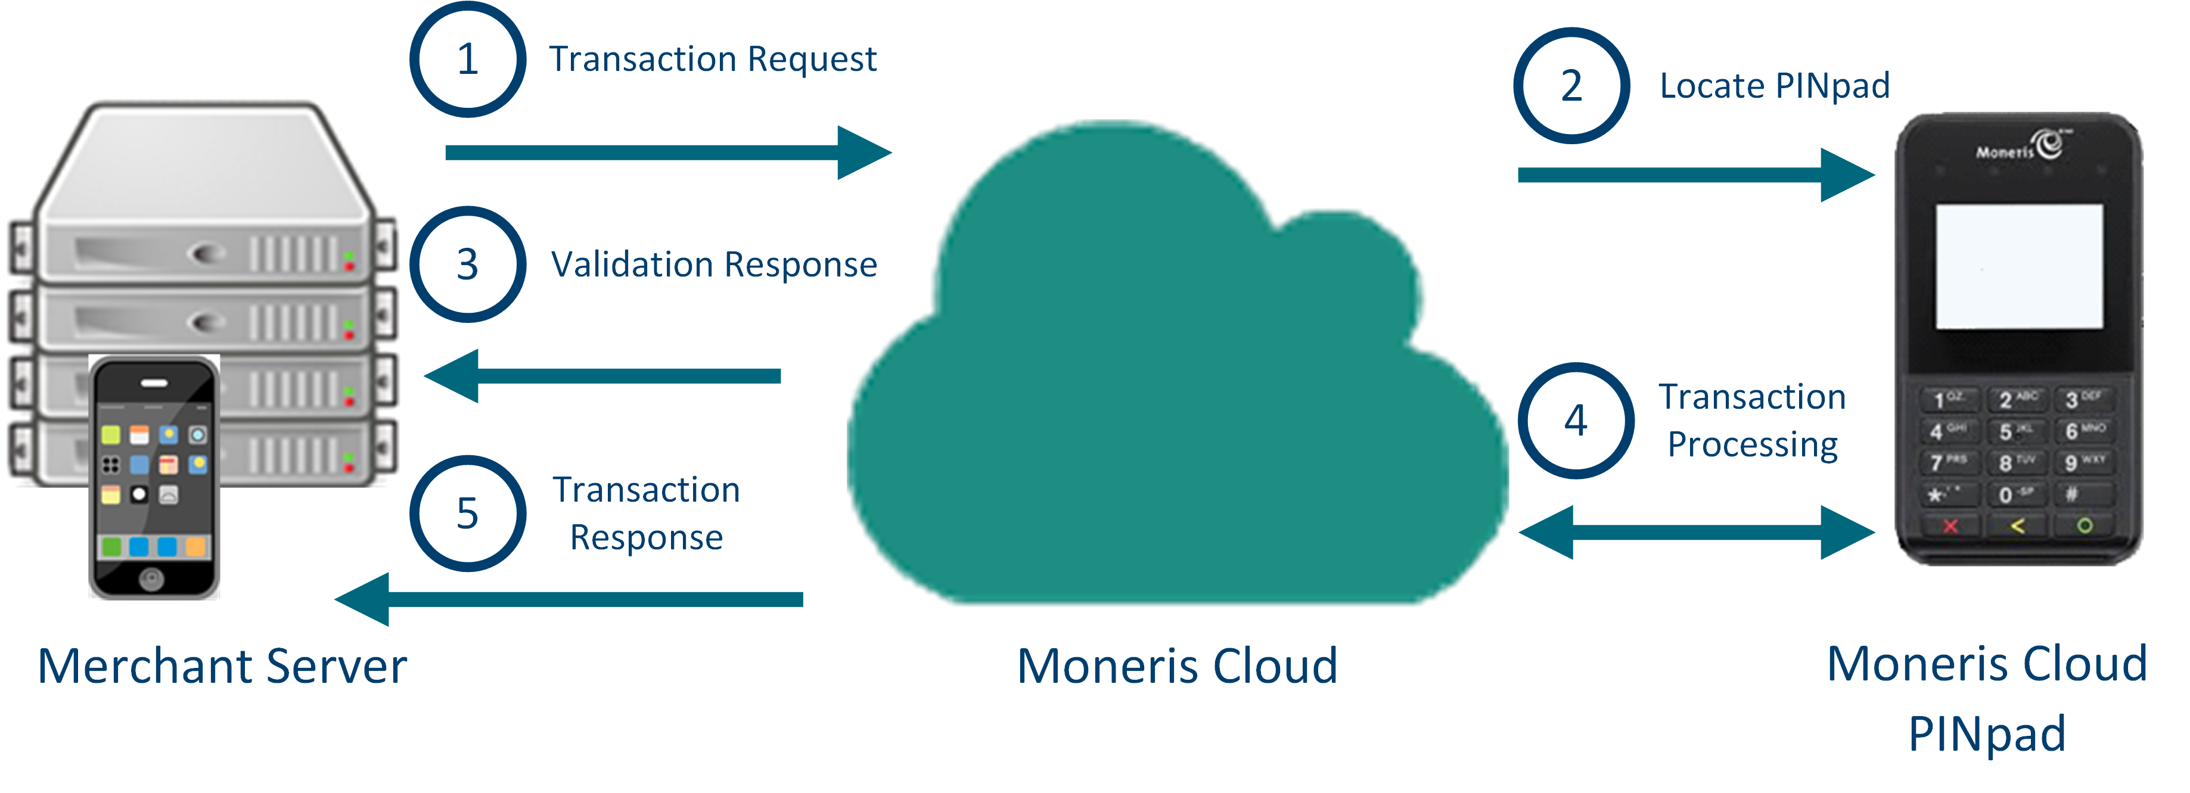
System Flow

Slide 5
System Configuration

Slide 6
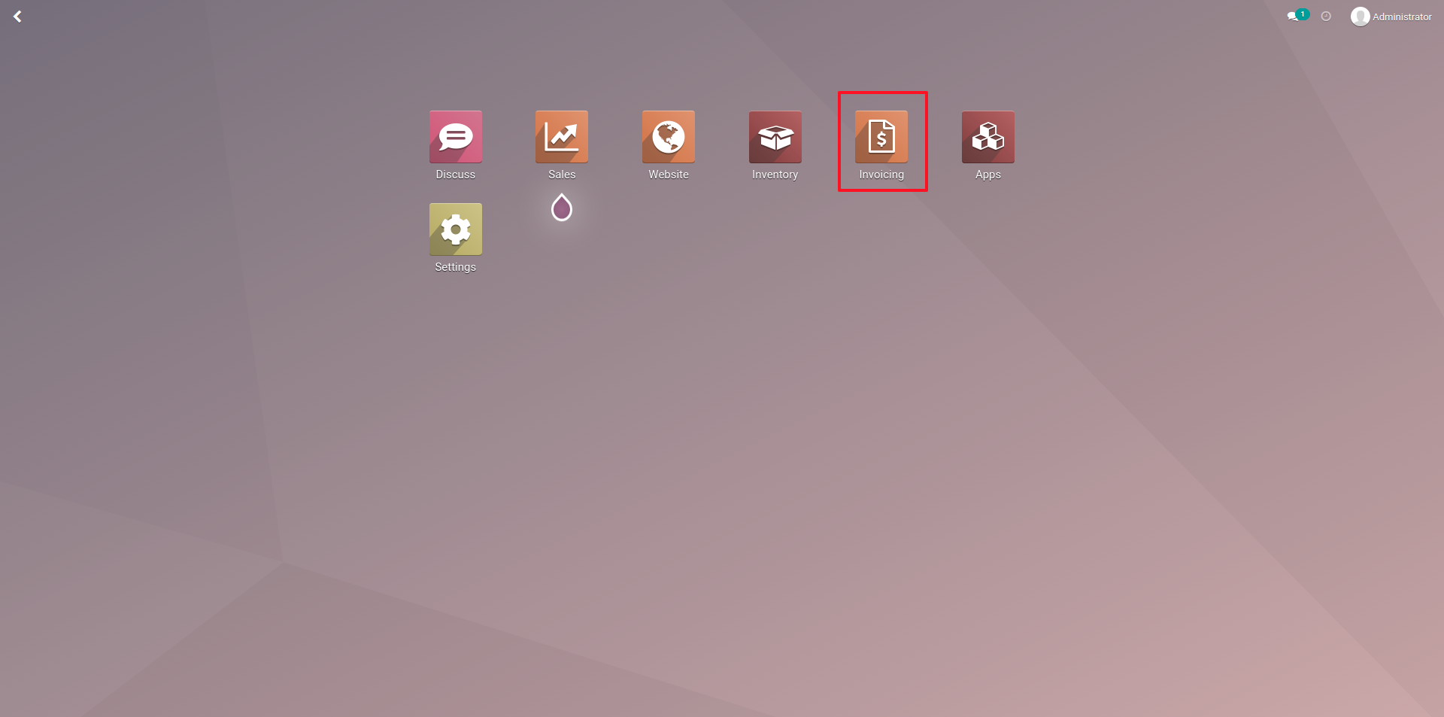
Invoice Configurations for Moneris Cloud
Go to Invoicing module.

Slide 7
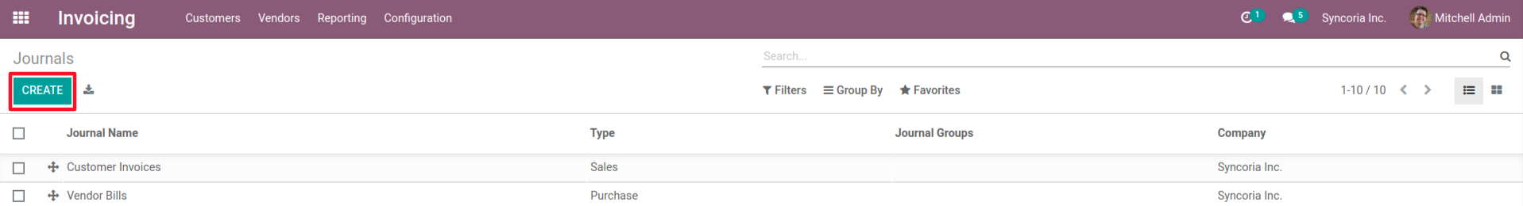
Invoice Configurations..
Go to Invoicing → Configuration → Journals
Click on “Create”

Slide 8
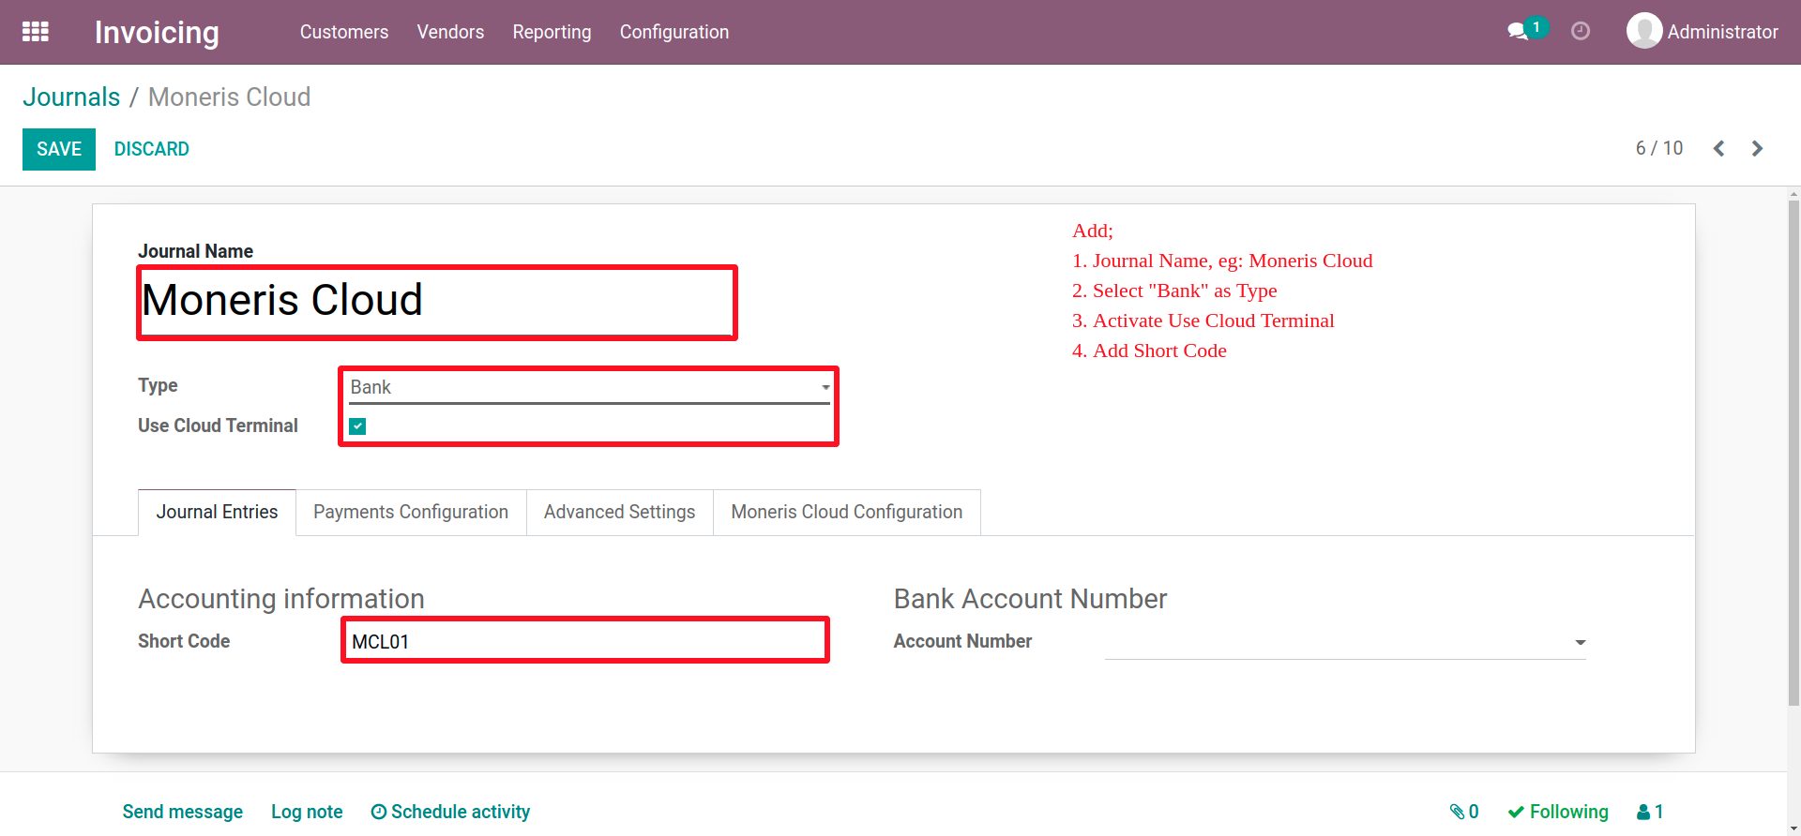
Invoice Configurations...
Add:
Journal Name
Activate “Use Moneris Terminal
Select “Bank” as Type

Slide 9
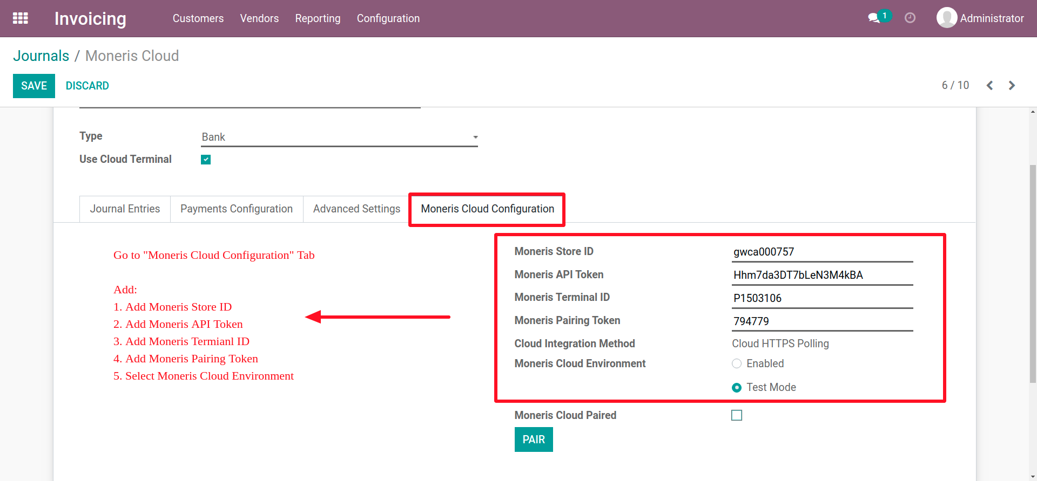
Invoice Configurations....

Slide 10
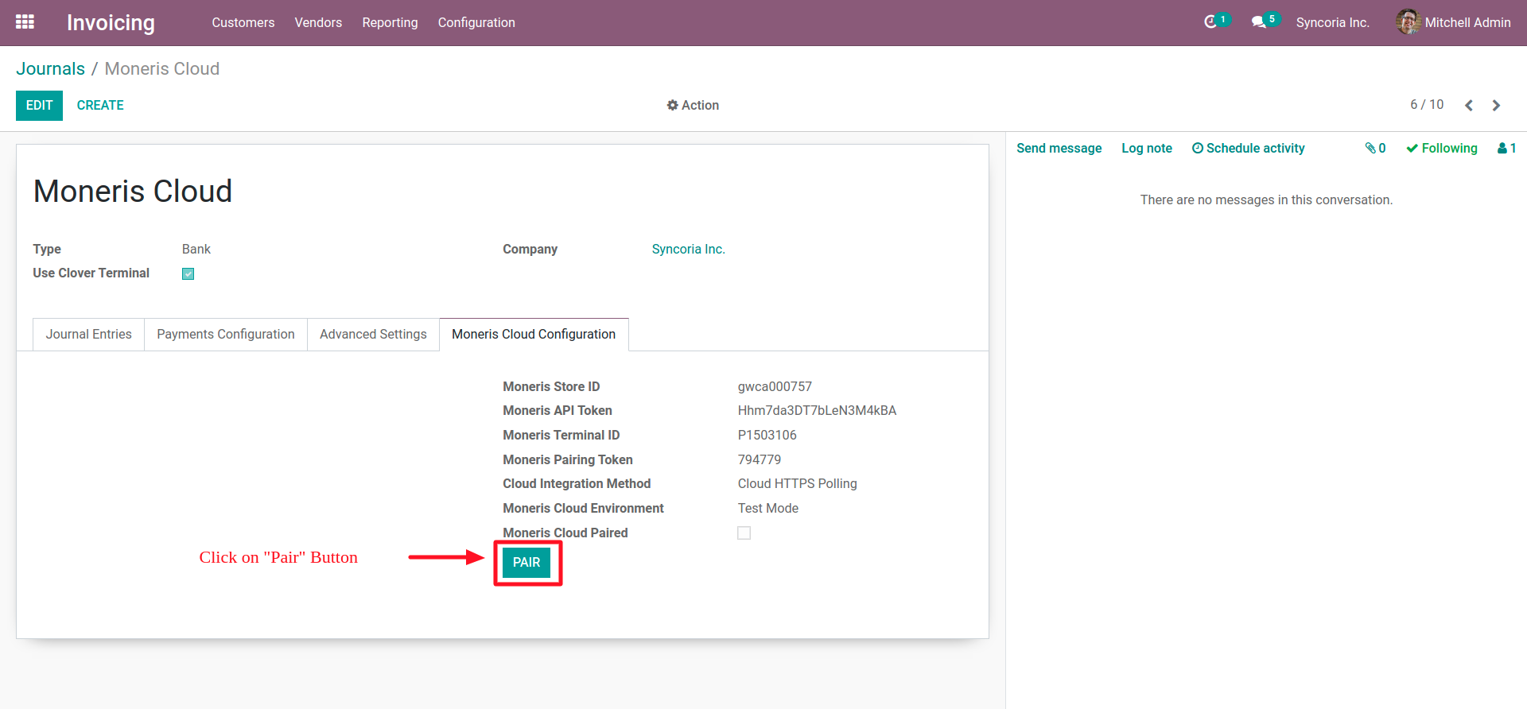
Invoice Configurations(Pair)

Slide 11
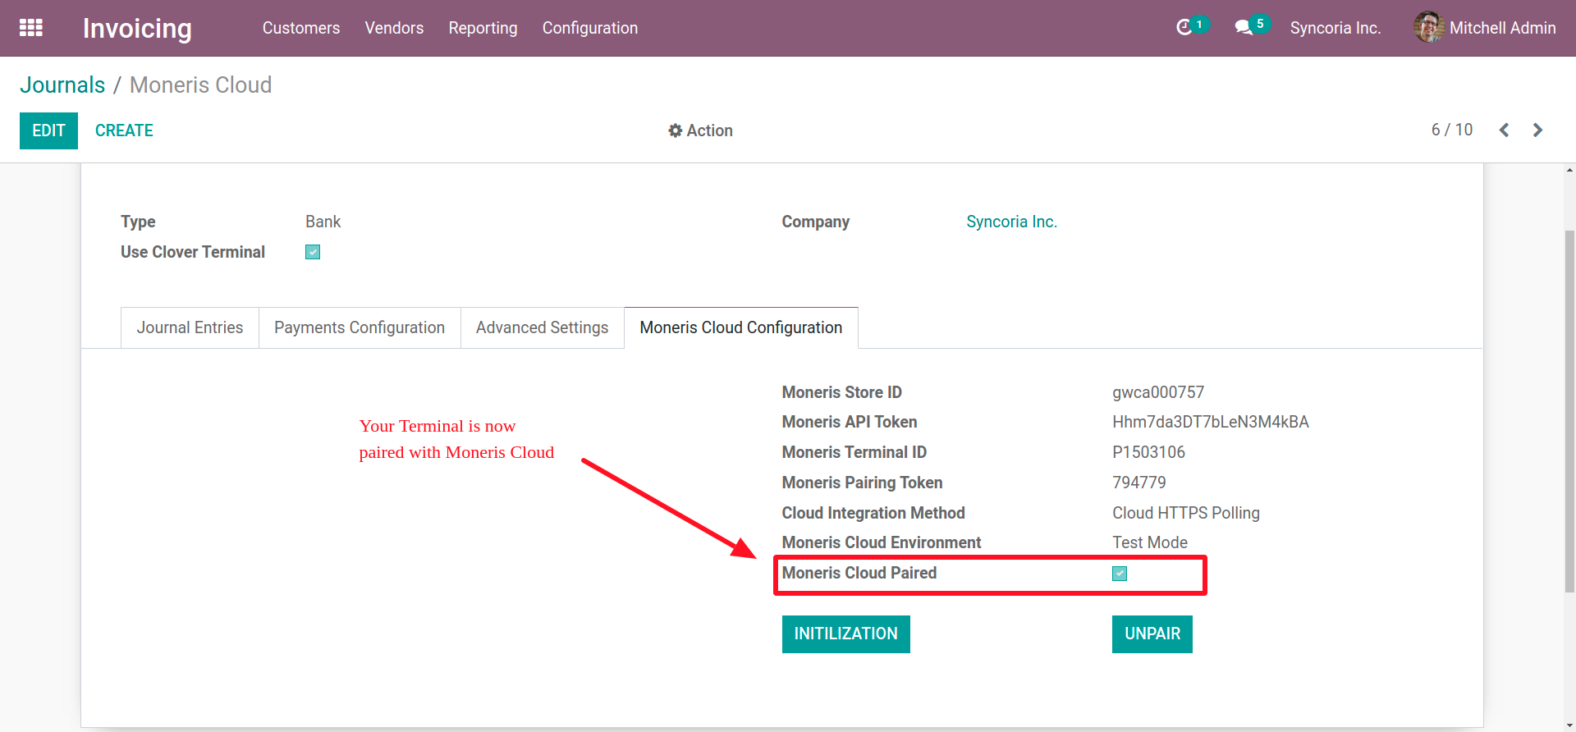
Invoice Configurations(Pair)..

Slide 12
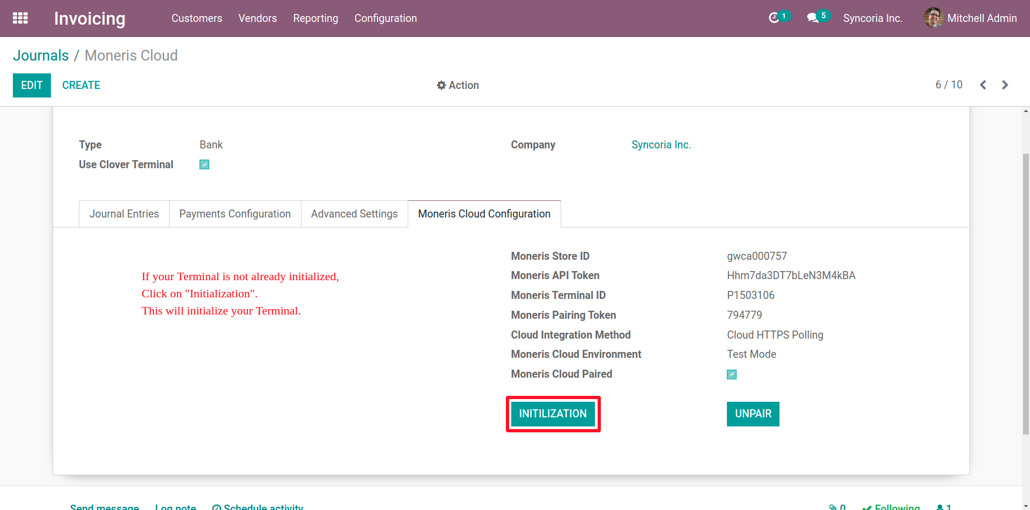
Invoice Configurations(Initialization)

Slide 13
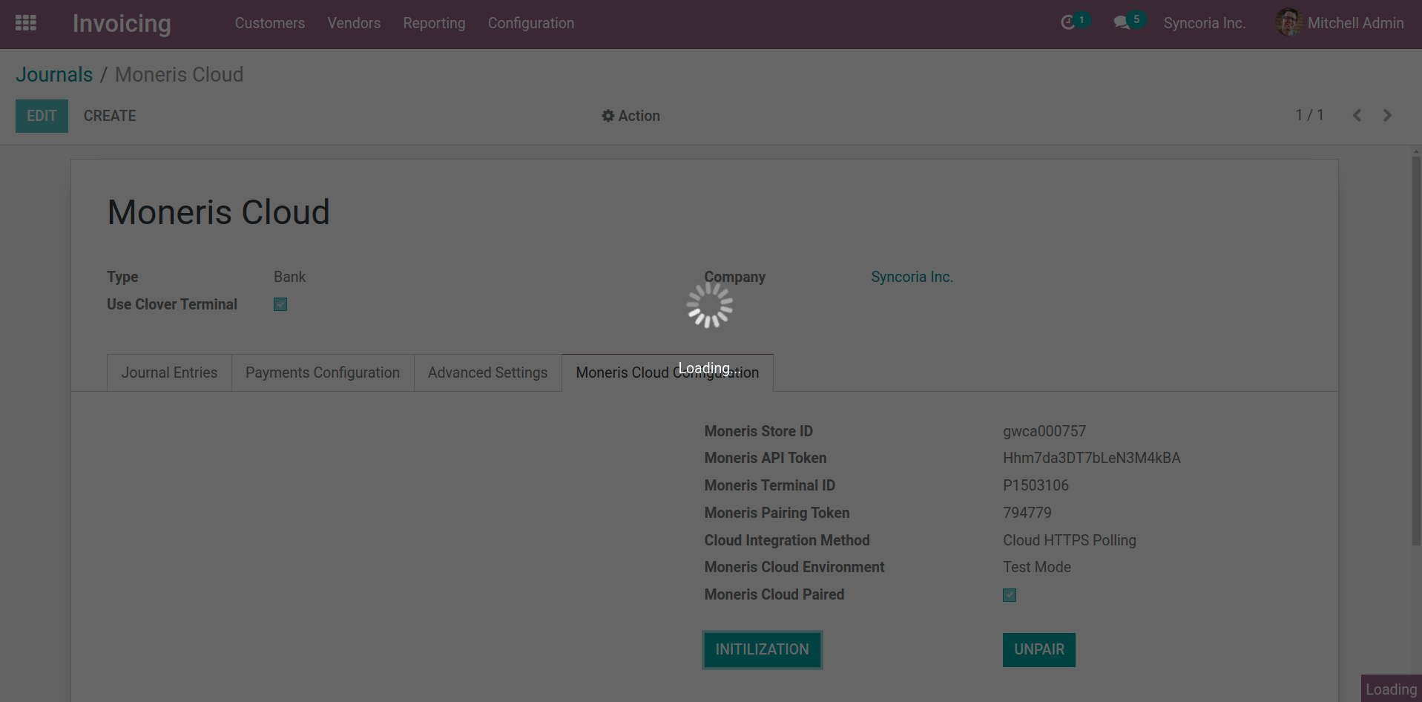
Invoice Configurations(Initialization)..

Slide 14
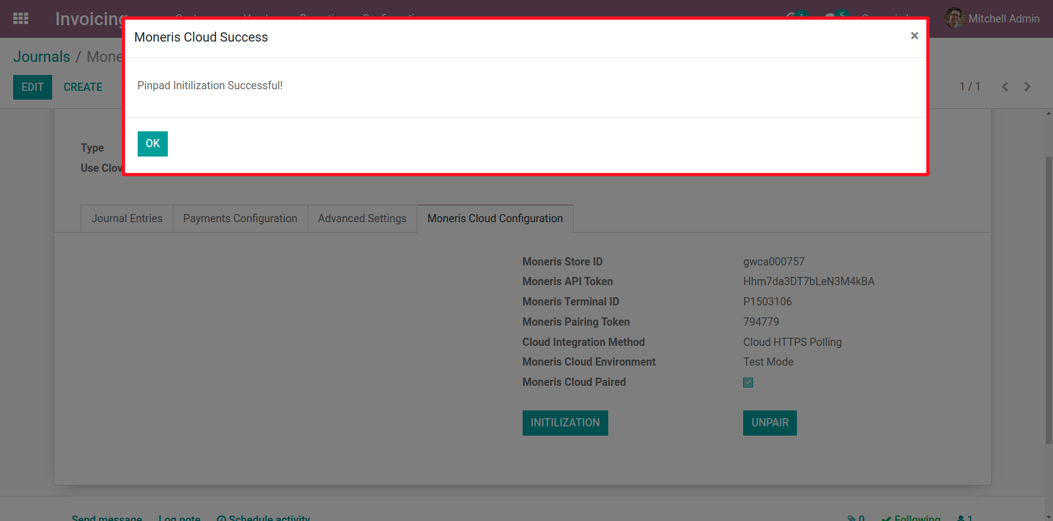
Invoice Configurations(Initialization)...

Slide 15
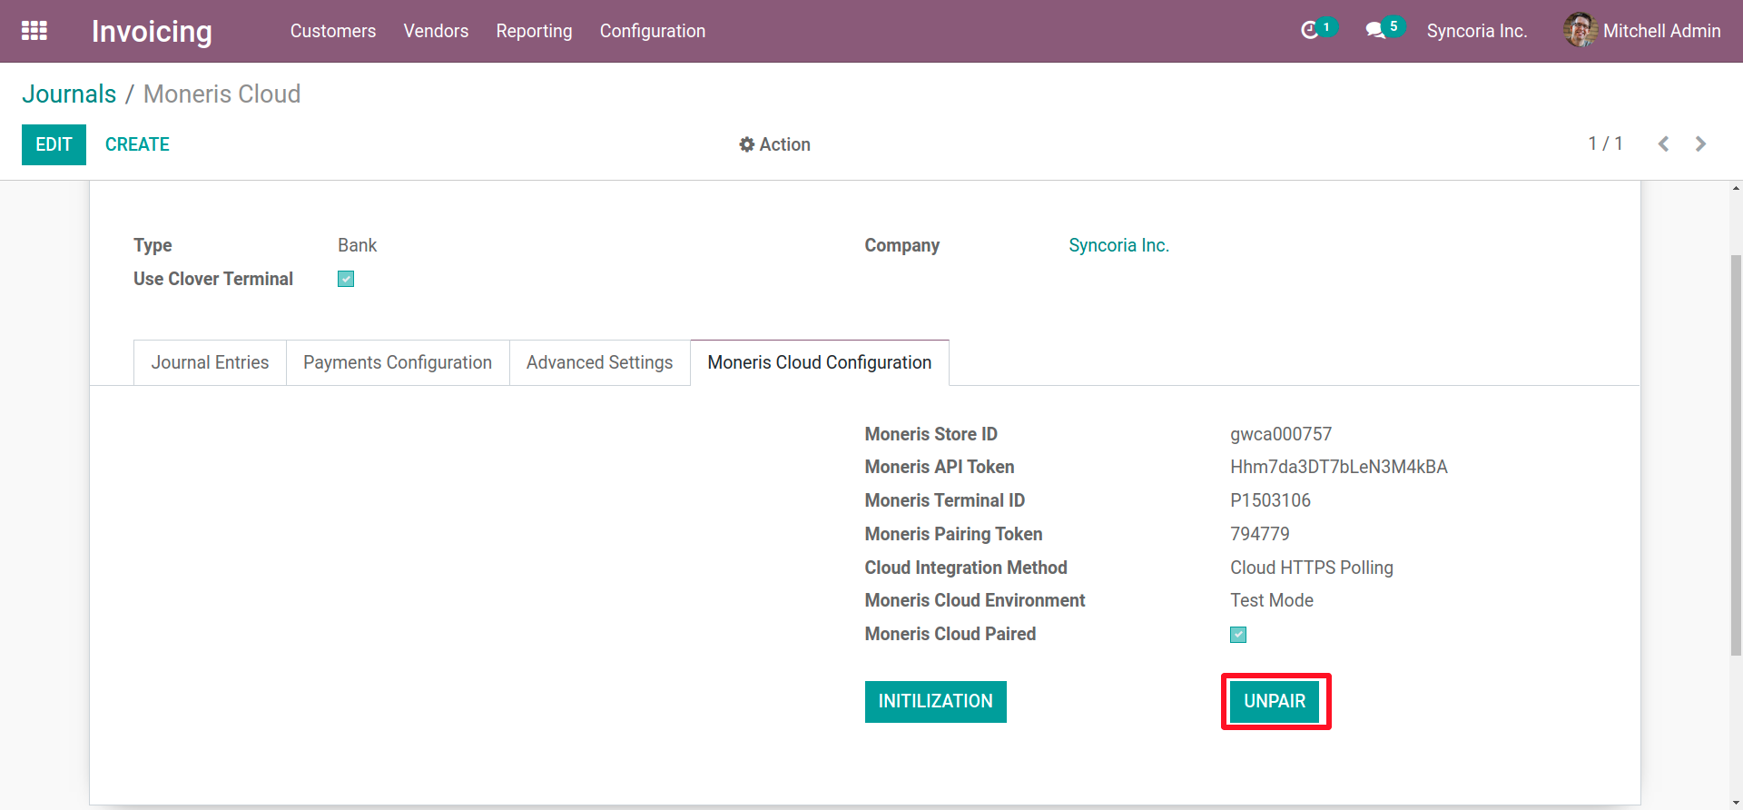
Invoice Configurations(Unpair)

Slide 16
Invoice Purchase Flow

Slide 17
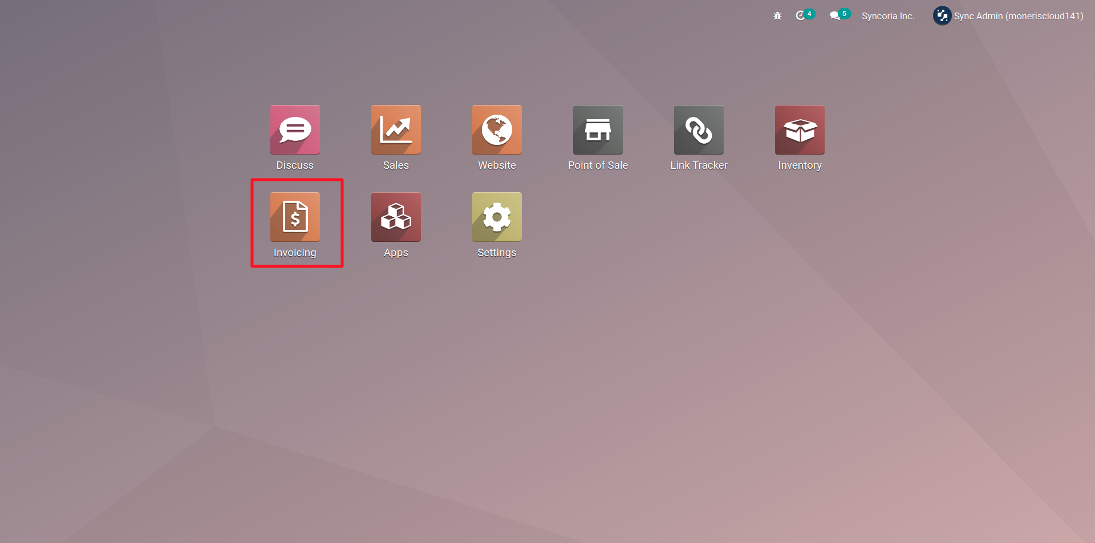
Invoice Purchase Flow

Slide 18
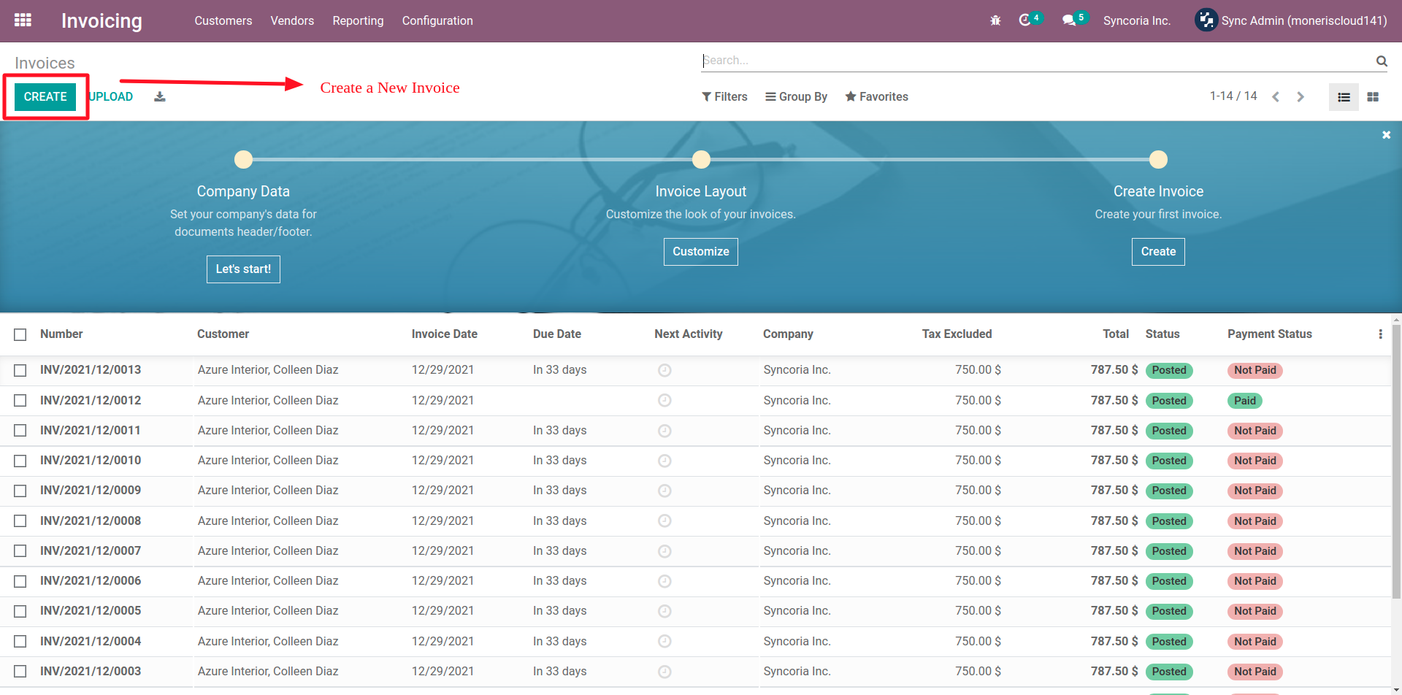
Invoice Purchase Flow..

Slide 19
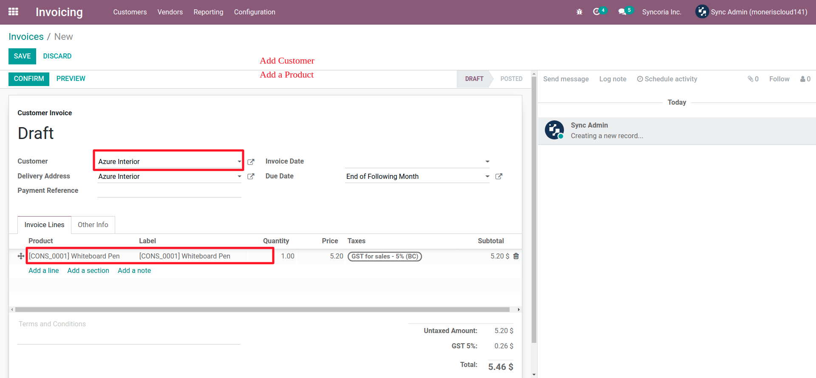
Invoice Purchase Flow...

Slide 20
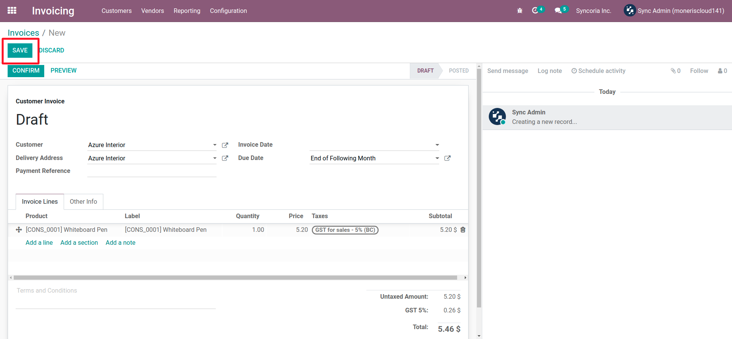
Invoice Purchase Flow...

Slide 21
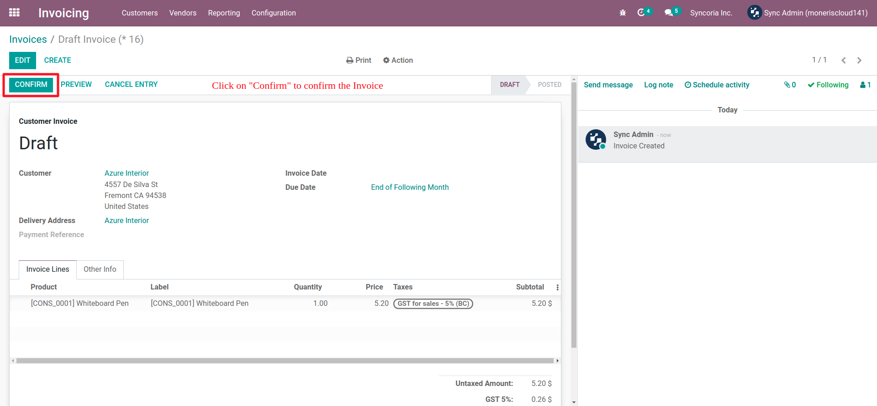
Invoice Purchase Flow...

Slide 22
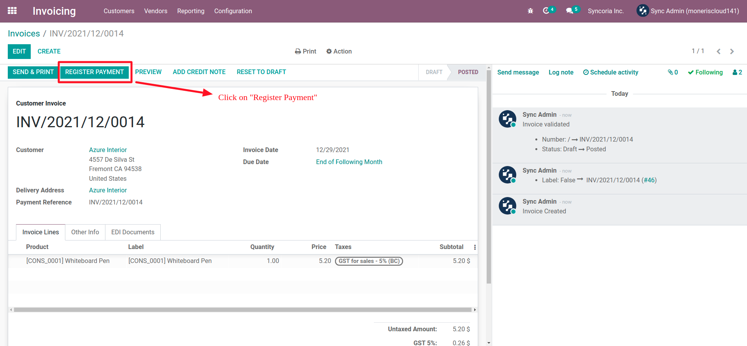
Invoice Purchase Flow...

Slide 23
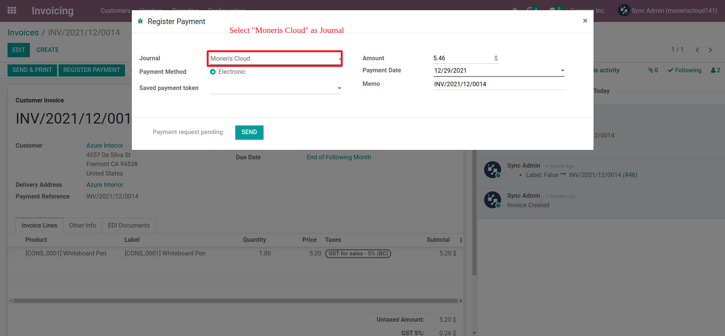
Invoice Purchase Flow...

Slide 24
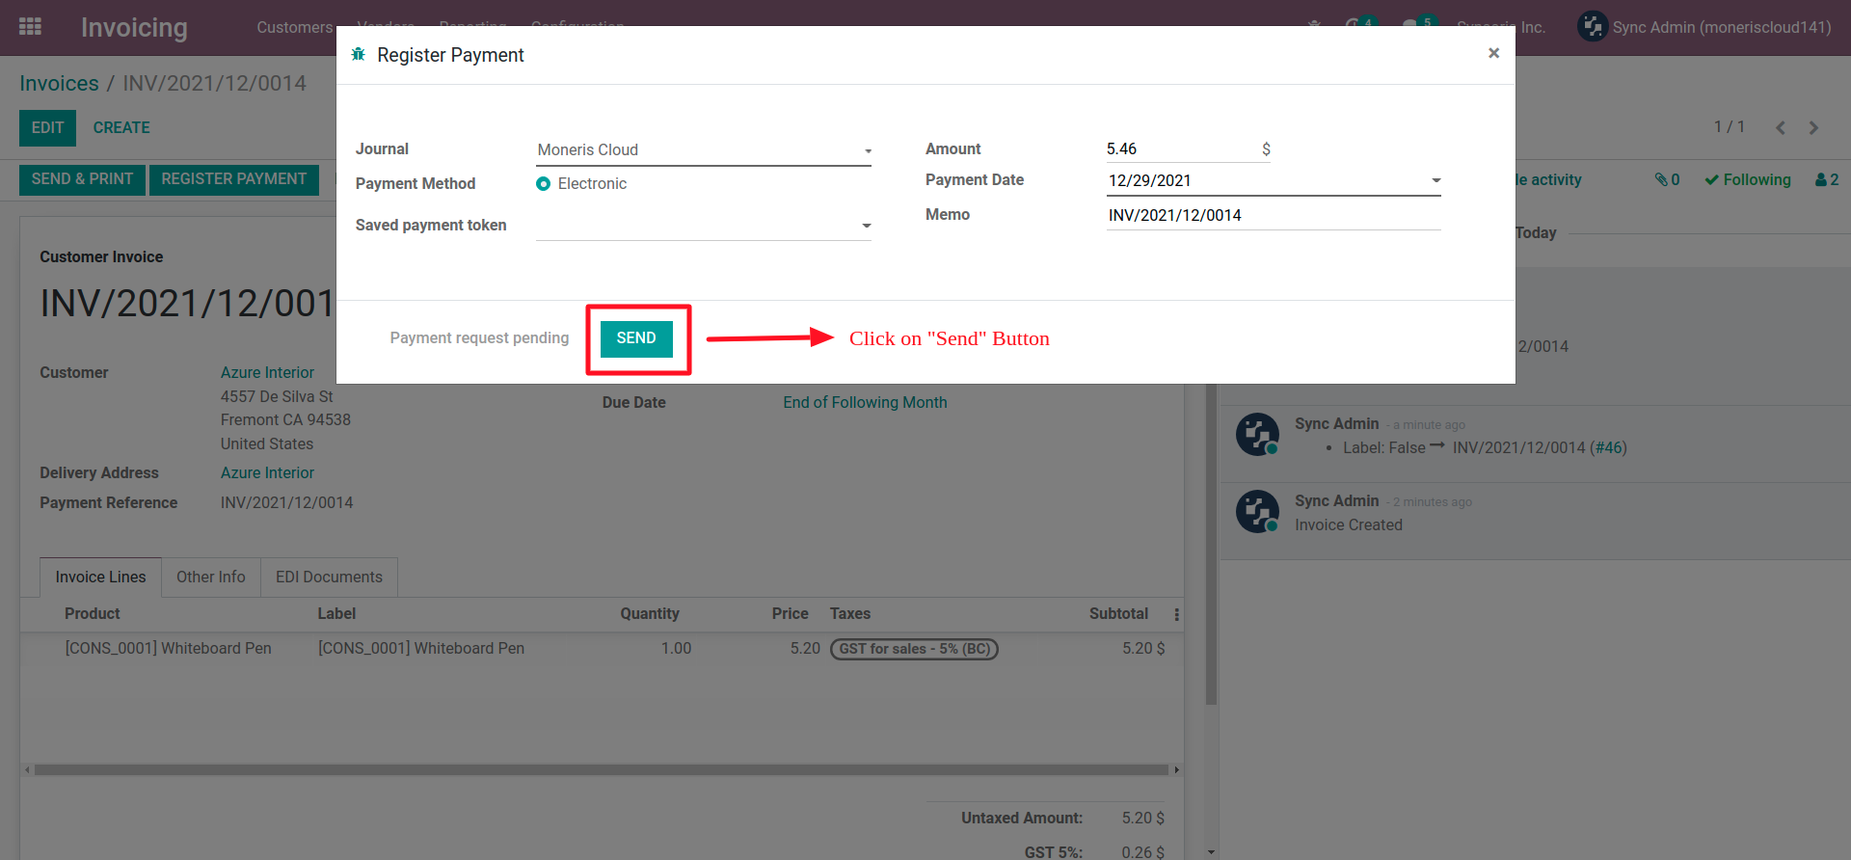
Invoice Purchase Flow...

Slide 25
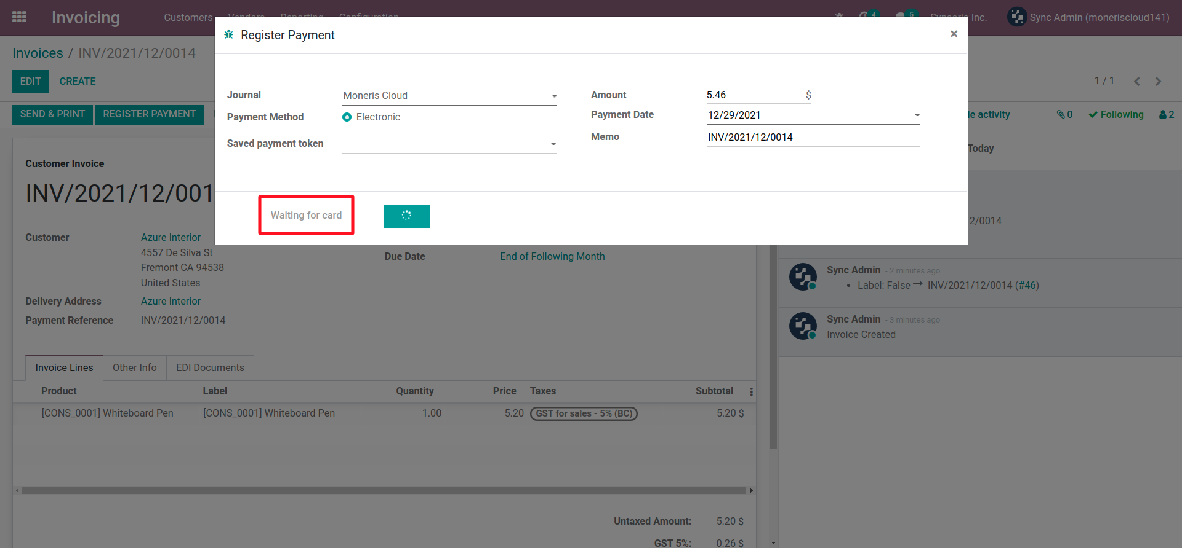
Invoice Purchase Flow...

Slide 26
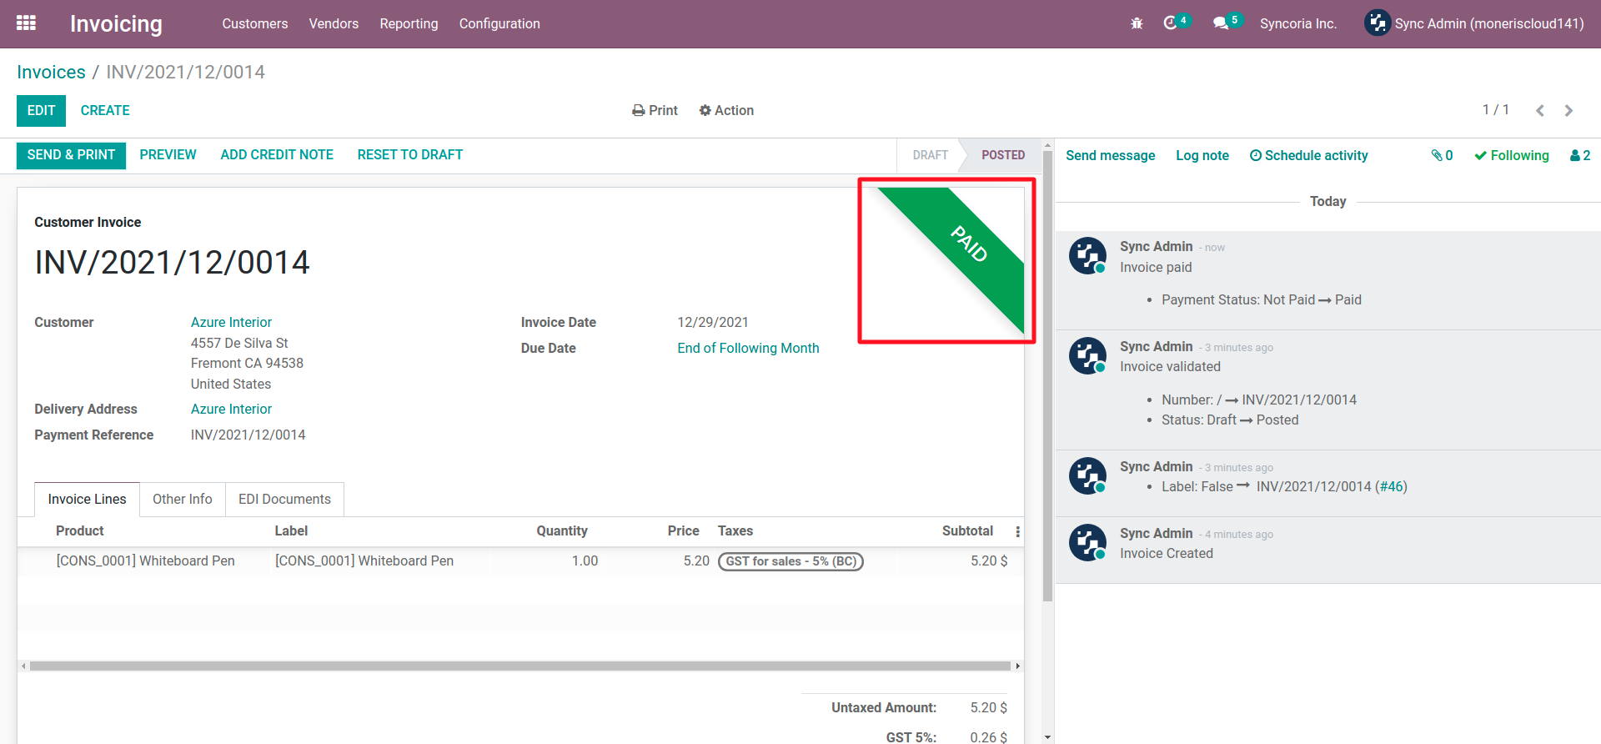
Invoice Purchase Flow...

Slide 27
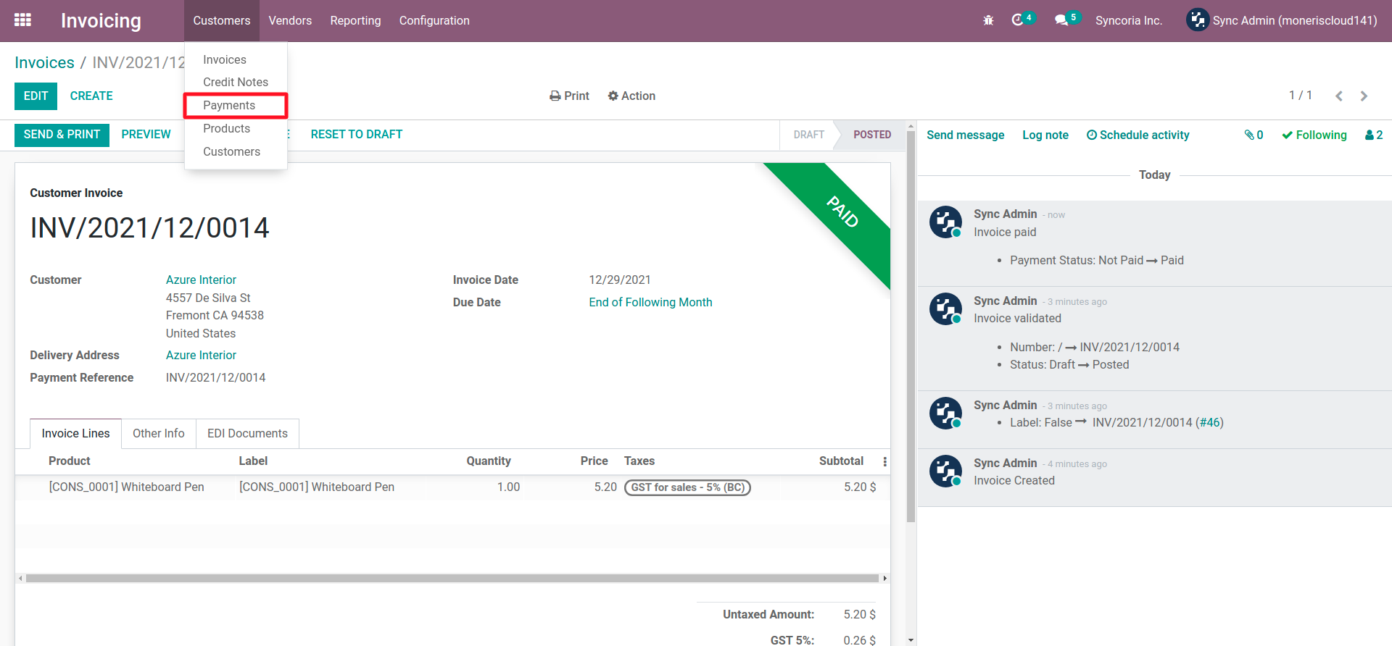
Invoice Purchase Flow...

Slide 28
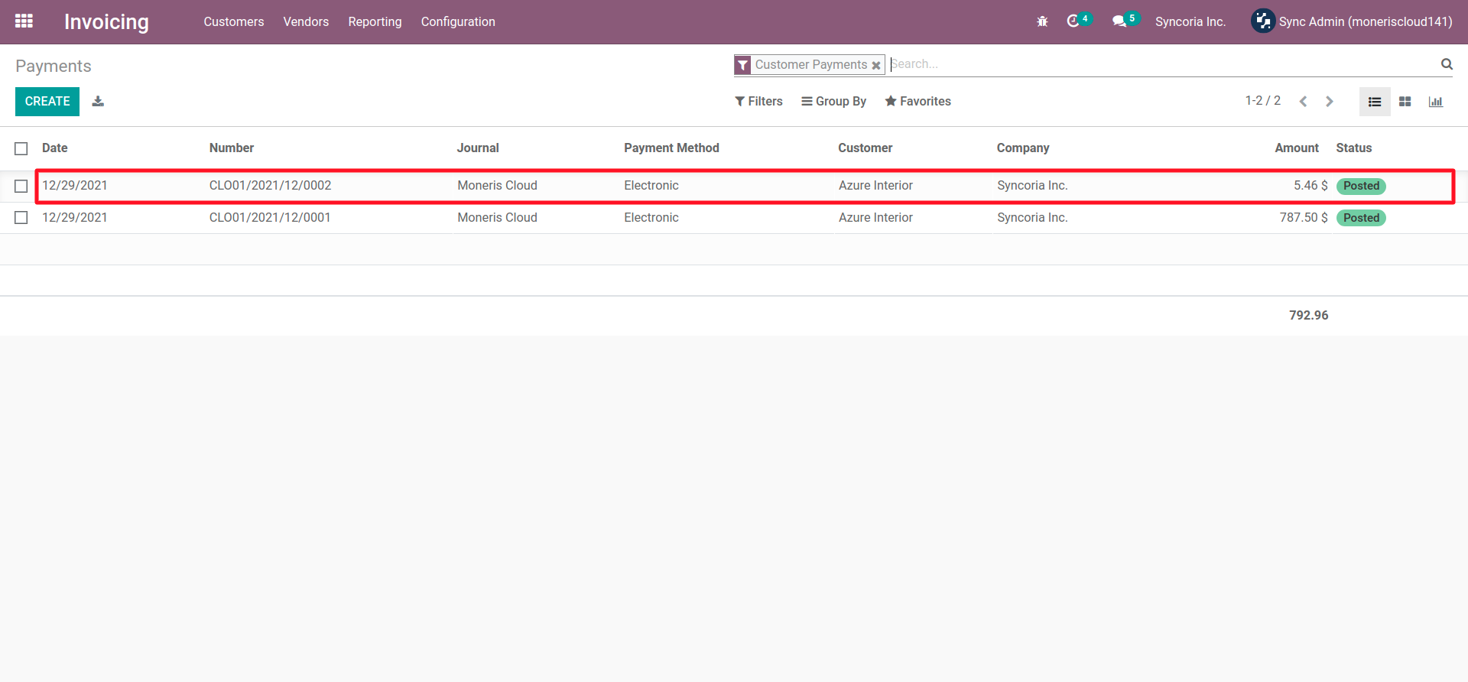
Invoice Purchase Flow...

Slide 29
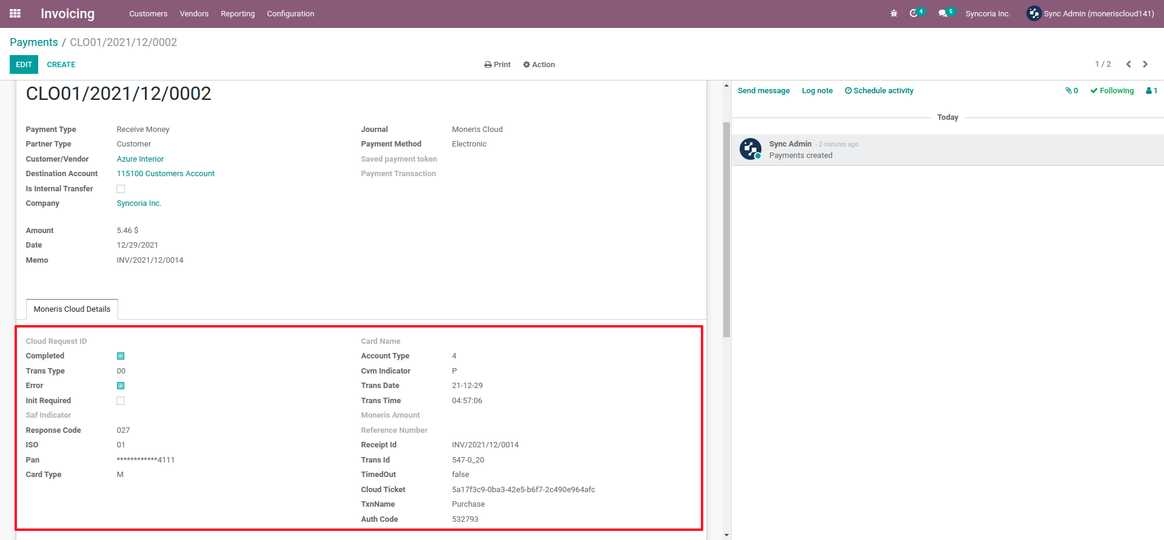
Invoice Purchase Flow...

Slide 30
Invoice Purchase Flow...

Slide 31
POS Payments Flow

Slide 32
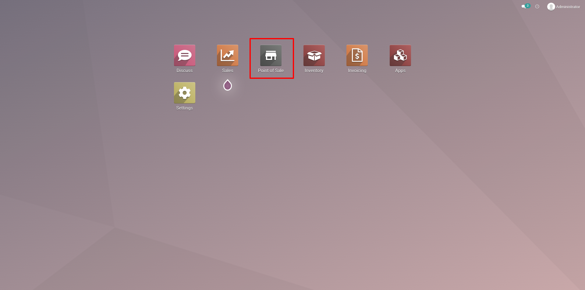
POS Payment Method Configuration
Go to Point of Sales module.

Slide 33
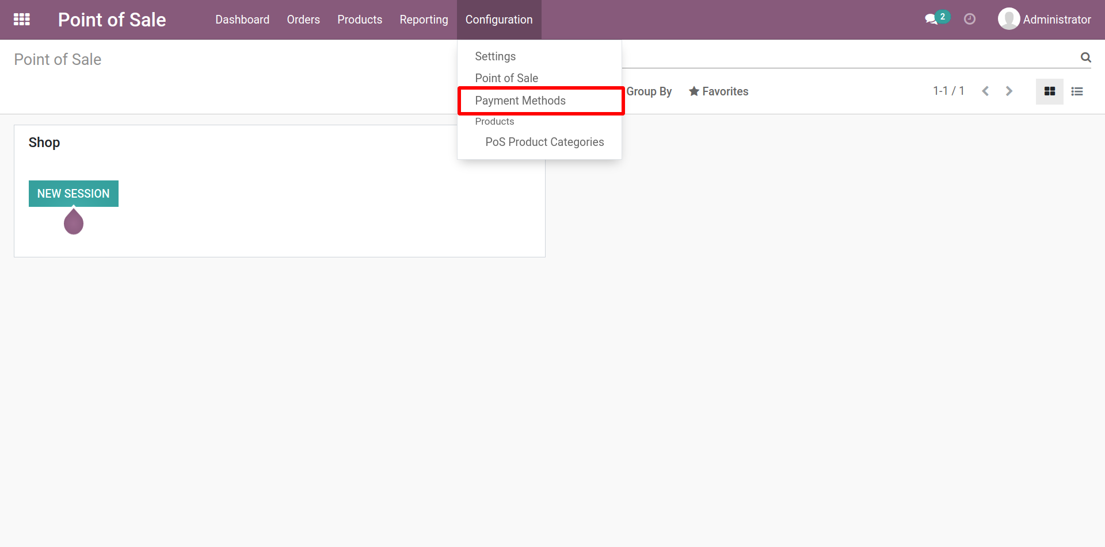
POS Payment Method Configuration …
Go to Configuration 🡪 Payment Methods.

Slide 34
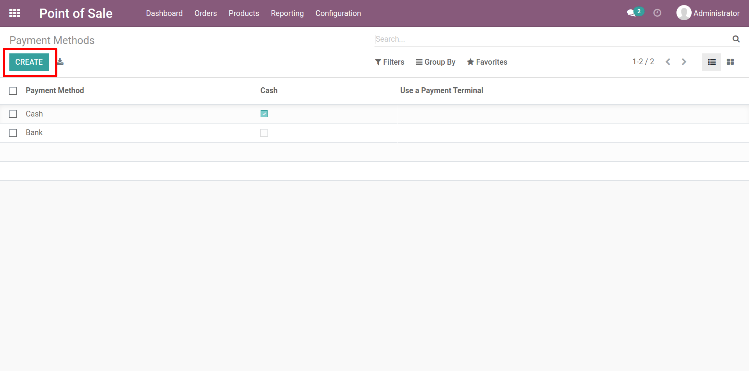
POS Payment Method Configuration …
Now, Click on Create button to create a new Payment Methods.

Slide 35
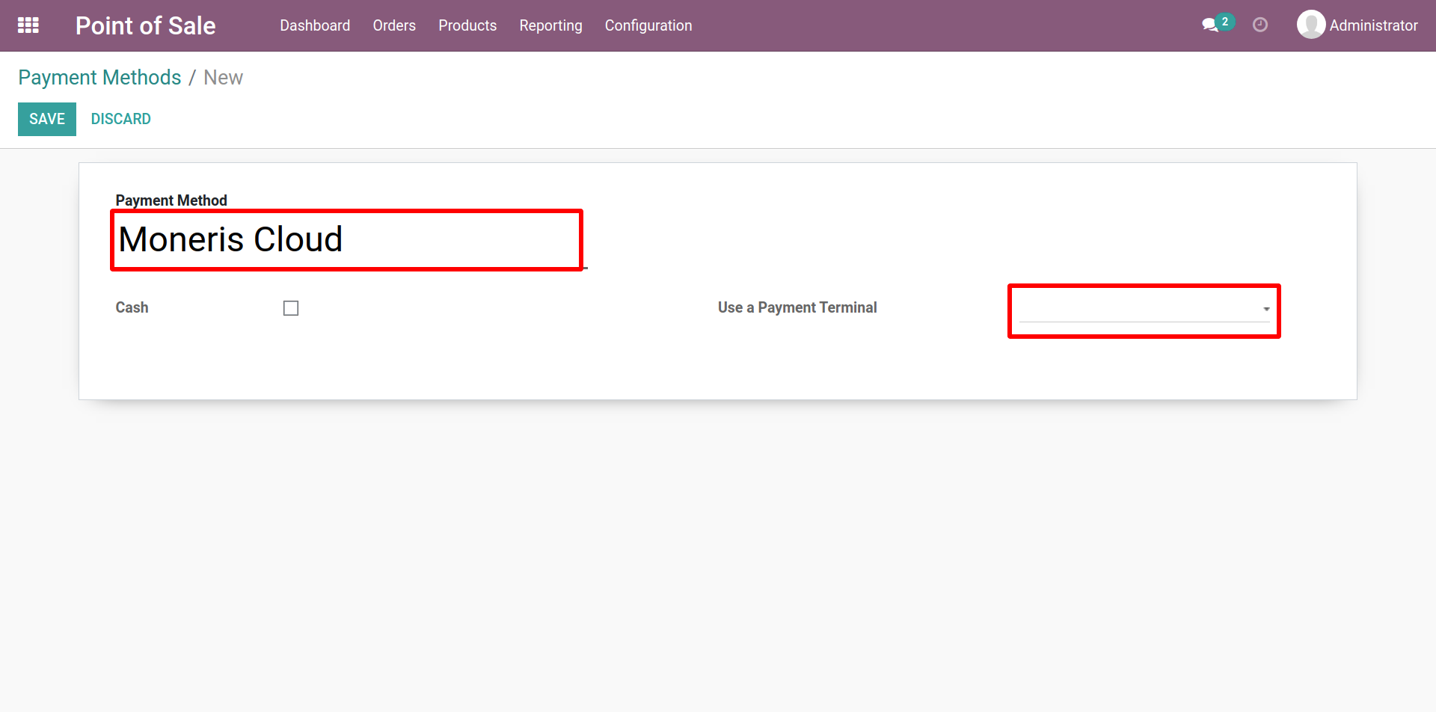
Payment Methods (Form View)
Give a Name for Payment Method.
Select Moneris Cloud as Use a Payment Terminal.

Slide 36
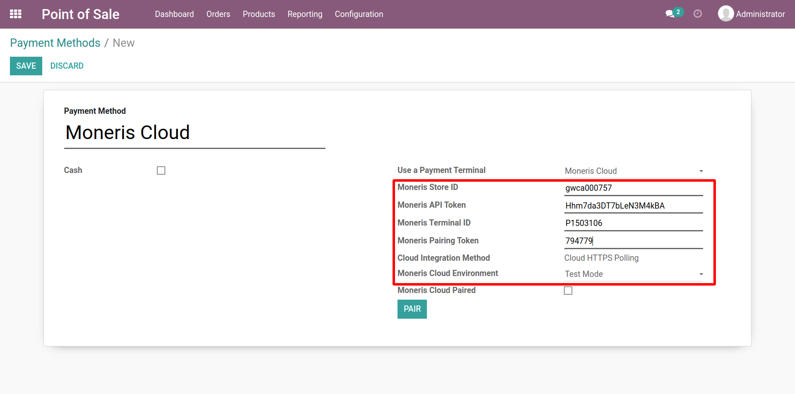
Payment Methods (Form View) …
Select Moneris Cloud and other information as per needs.

Slide 37
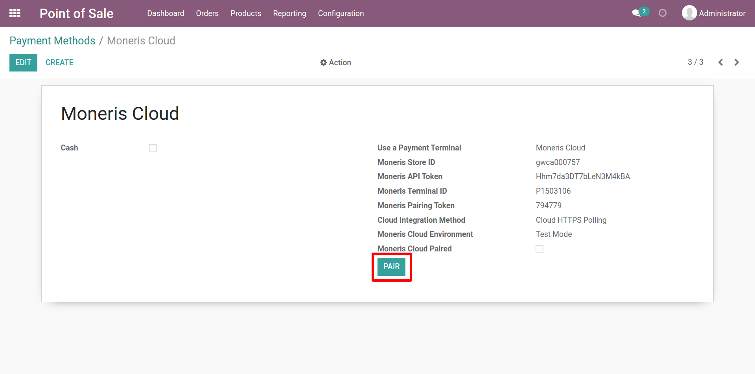
Payment Methods (Form View) …
Now, Click on the “PAIR” button.

Slide 38
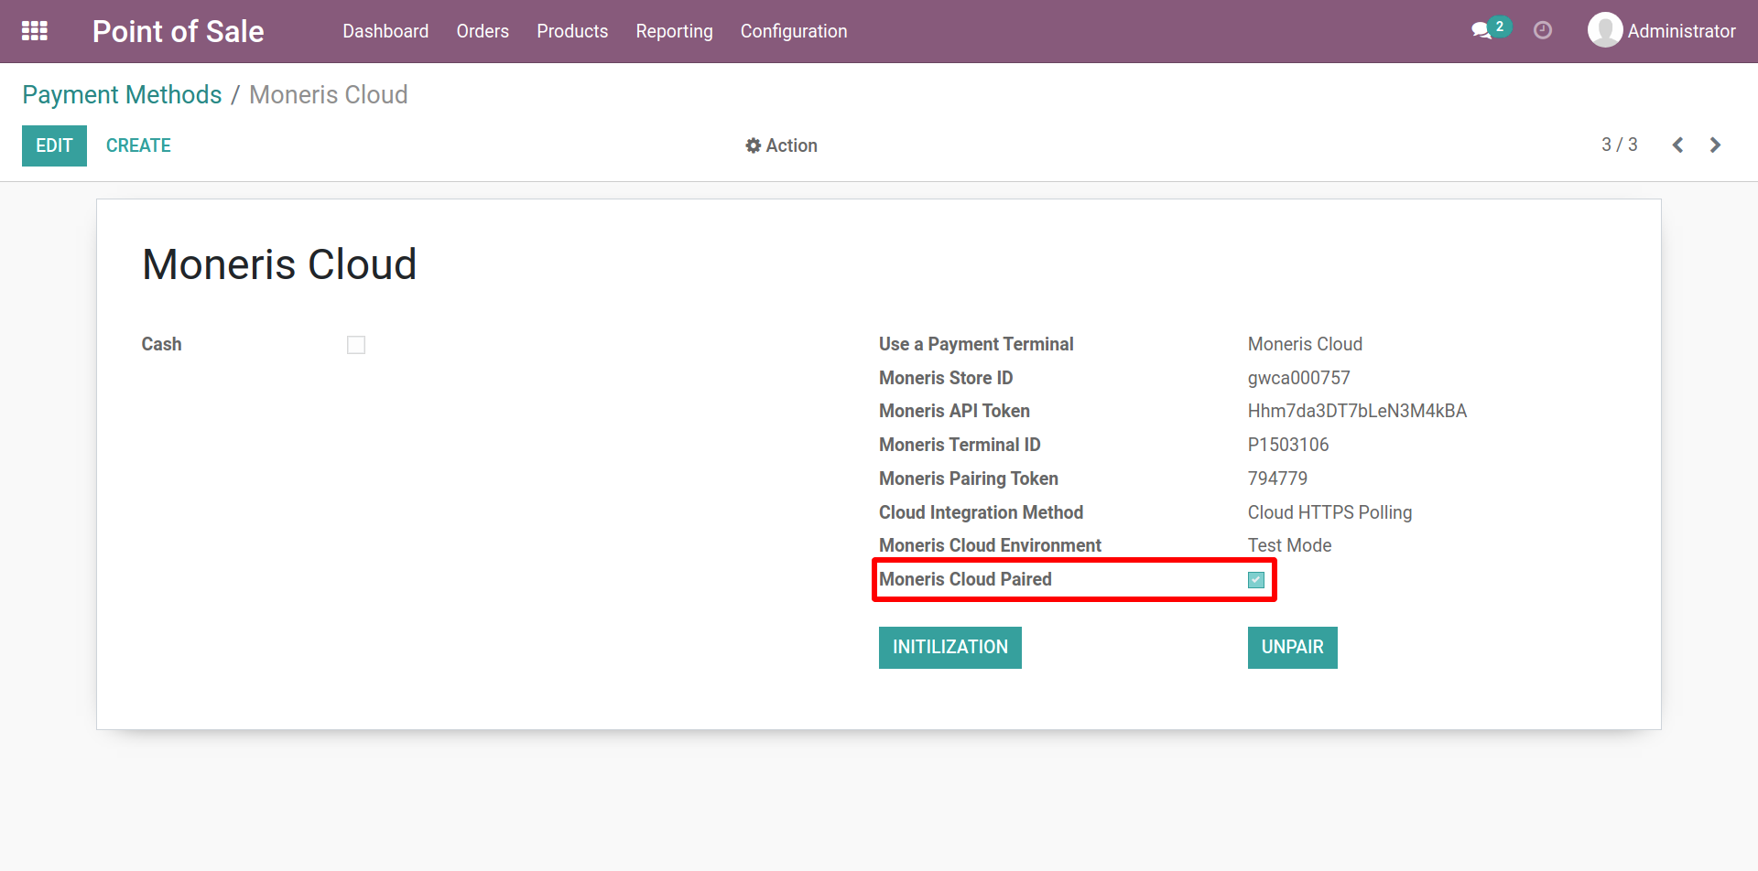
Payment Methods (Form View) …
After clicking on the pair button “Moneris Cloud Paired” option will automatically enabled.

Slide 39
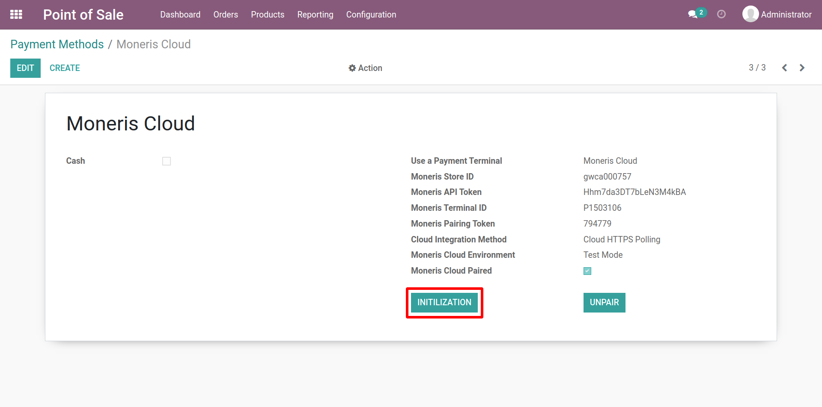
Payment Methods (Form View) …
Now, click on the “INITILIZATION” button.

Slide 40
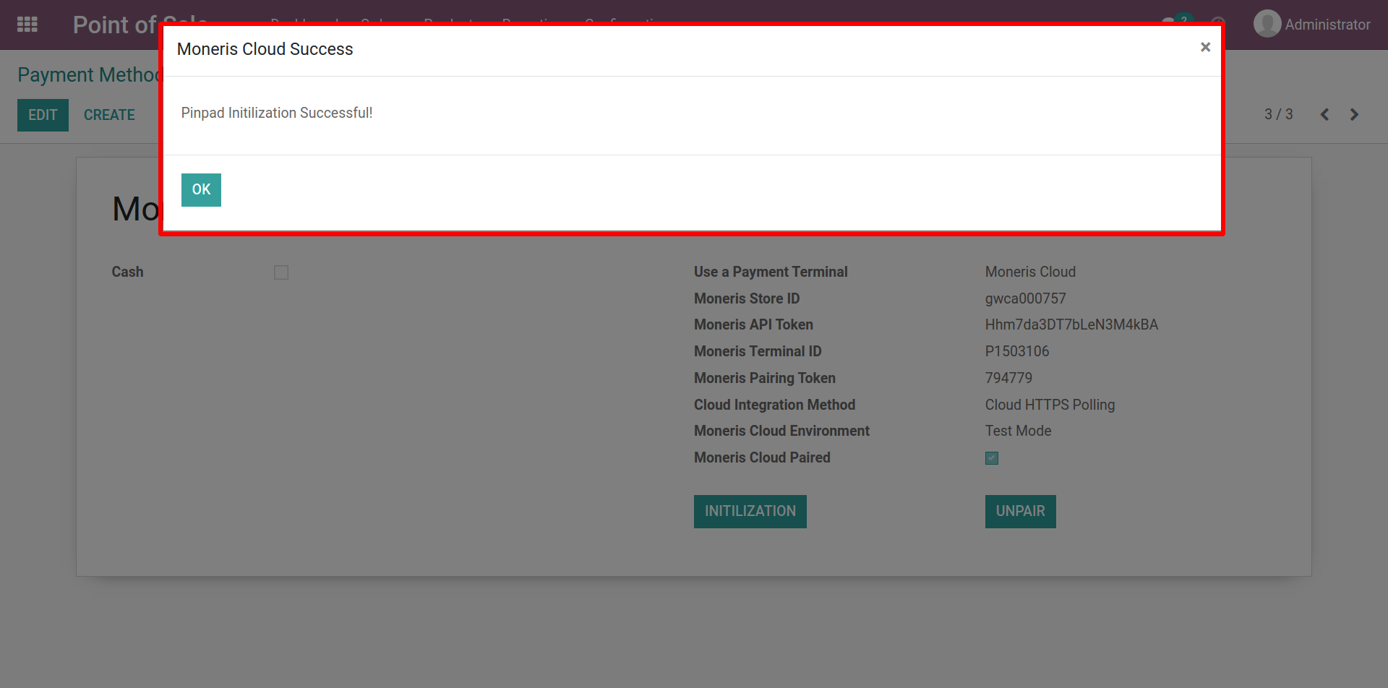
Payment Methods (Form View) …
After Click on the initialization button this pop-up message will appear.

Slide 41
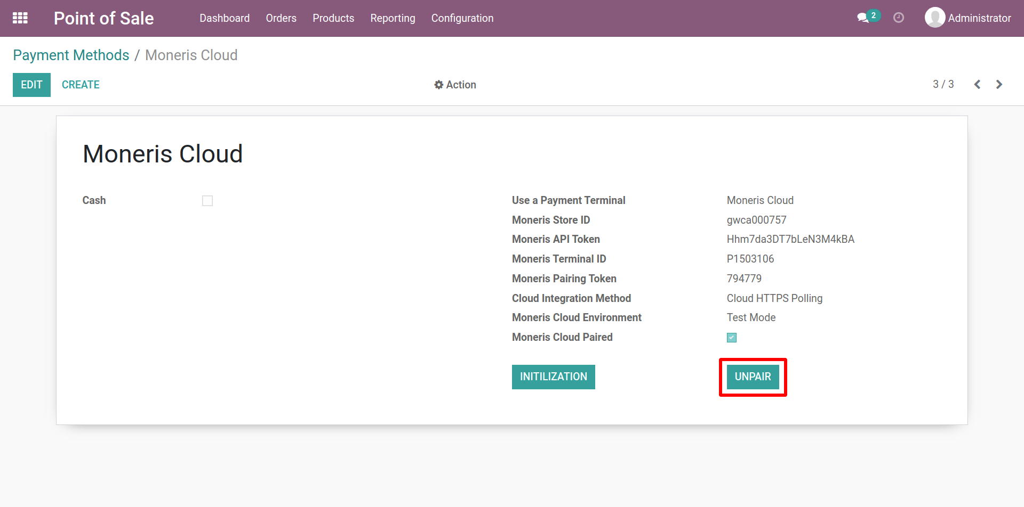
Payment Methods (Form View) …
Now, Click on the “Unpair” button.

Slide 42
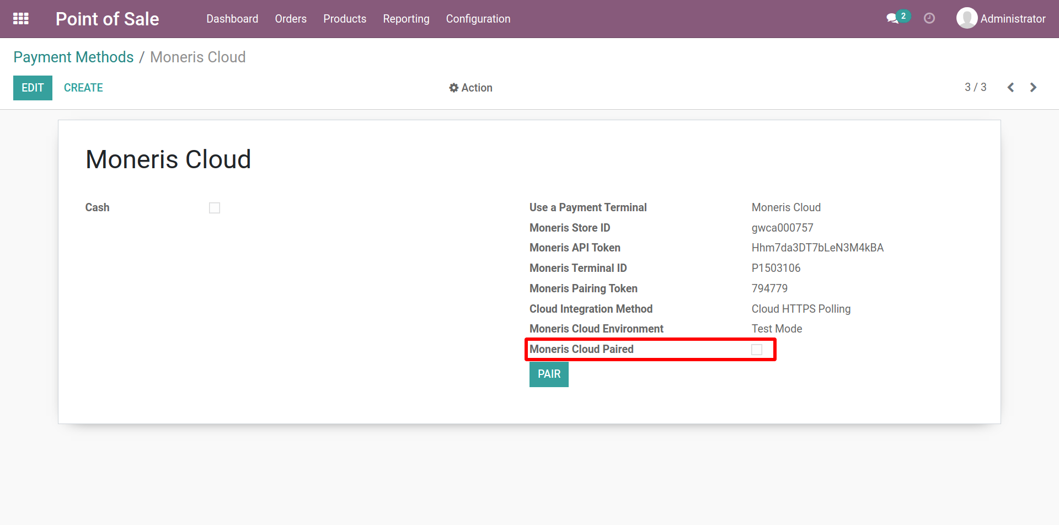
Payment Methods (Form View) …
After clicking on the unpair button the “Moneris Cloud Paired” option will automatically disabled.

Slide 43
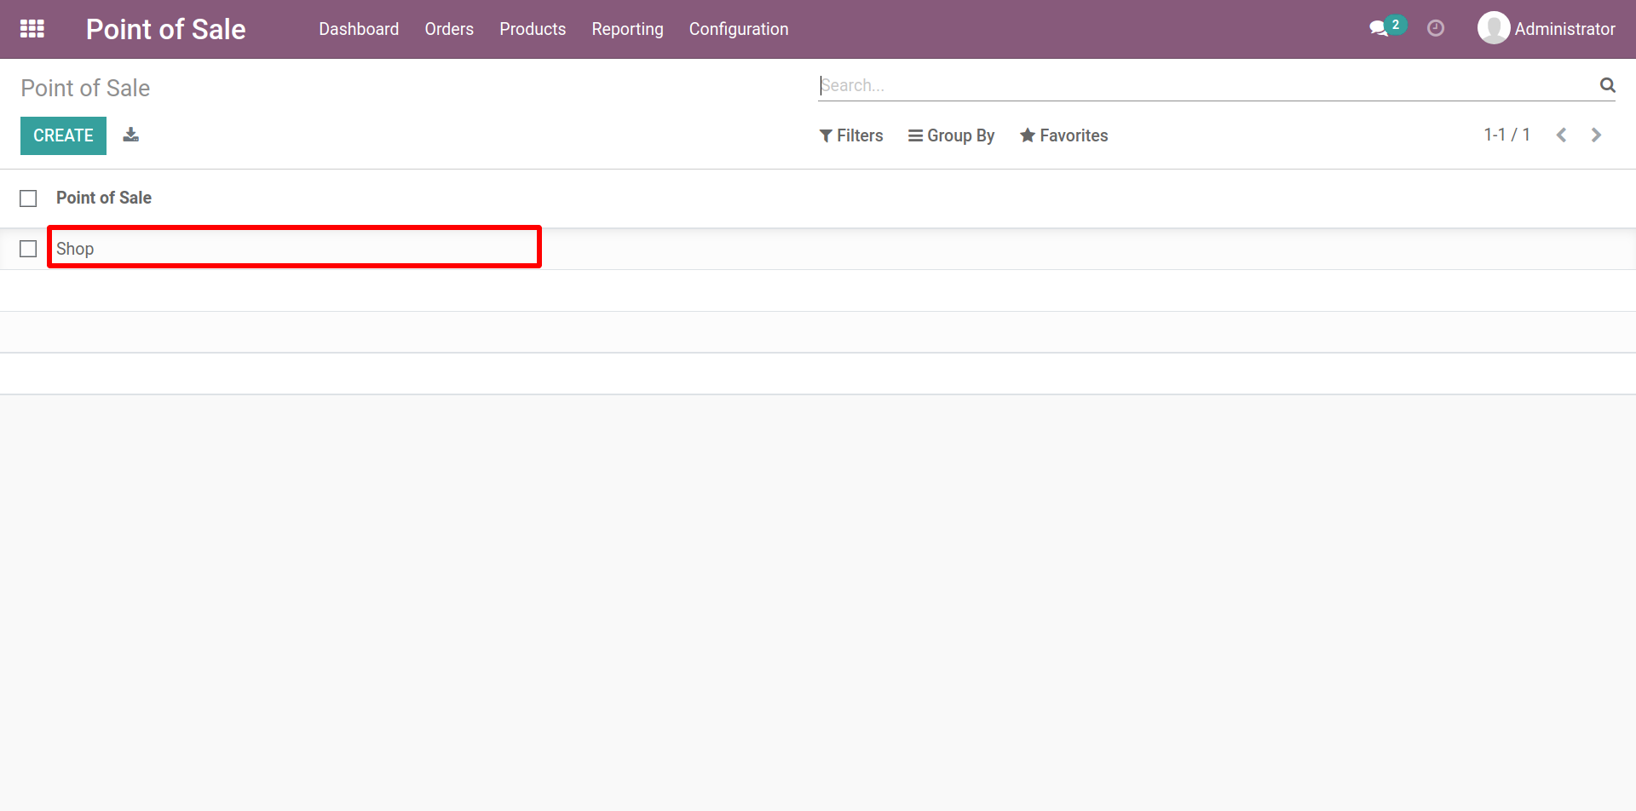
Point of Sale Configuration
Go to Configuration 🡪 Point of Sales.
Create or Select one that is already created.

Slide 44
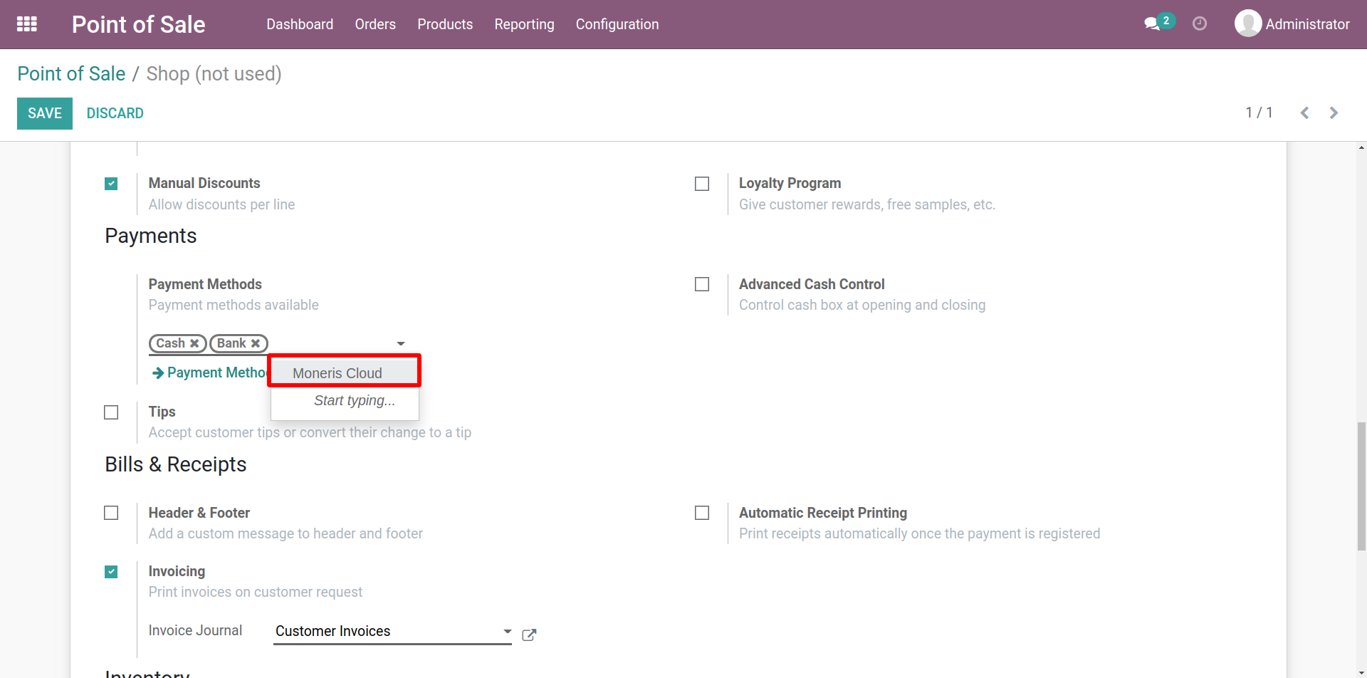
Point of Sales / Shop (Form View)
1. Add “Moneris Cloud” as Payment Methods under Payments

Slide 45
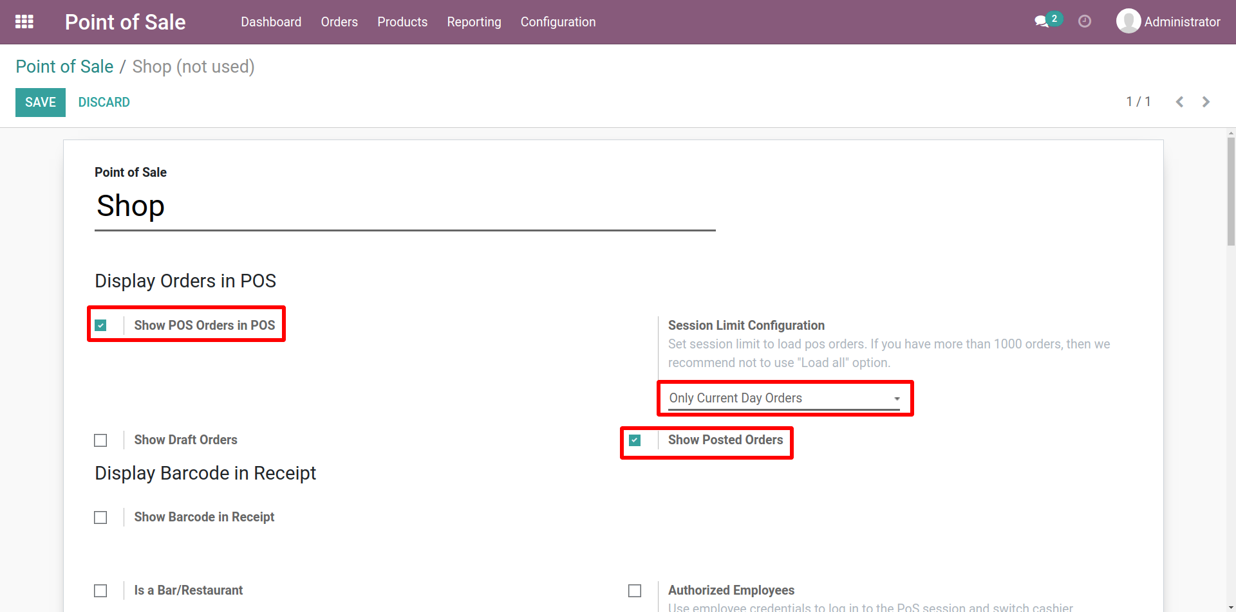
Point of Sales / Shop (Form View) …
1. Activate “Show POS Orders in POS”.
2. Select “Limit all sessions Orders” under Session Limit Configuration.
3. Activate “Show Posted Orders”.

Slide 46
Moneris Cloud Payment Process

Slide 47
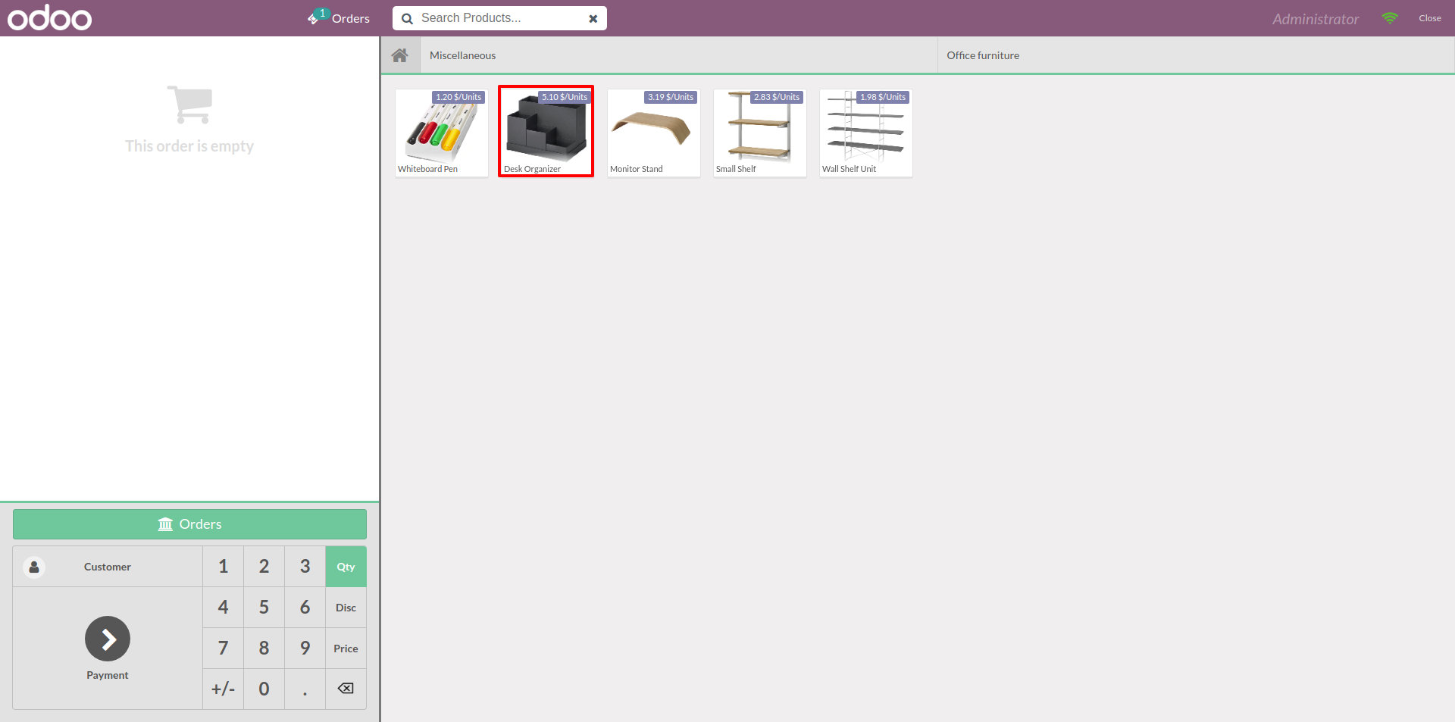
Purchase in Odoo POS
Click on the product to proceed or select the product to see details.

Slide 48
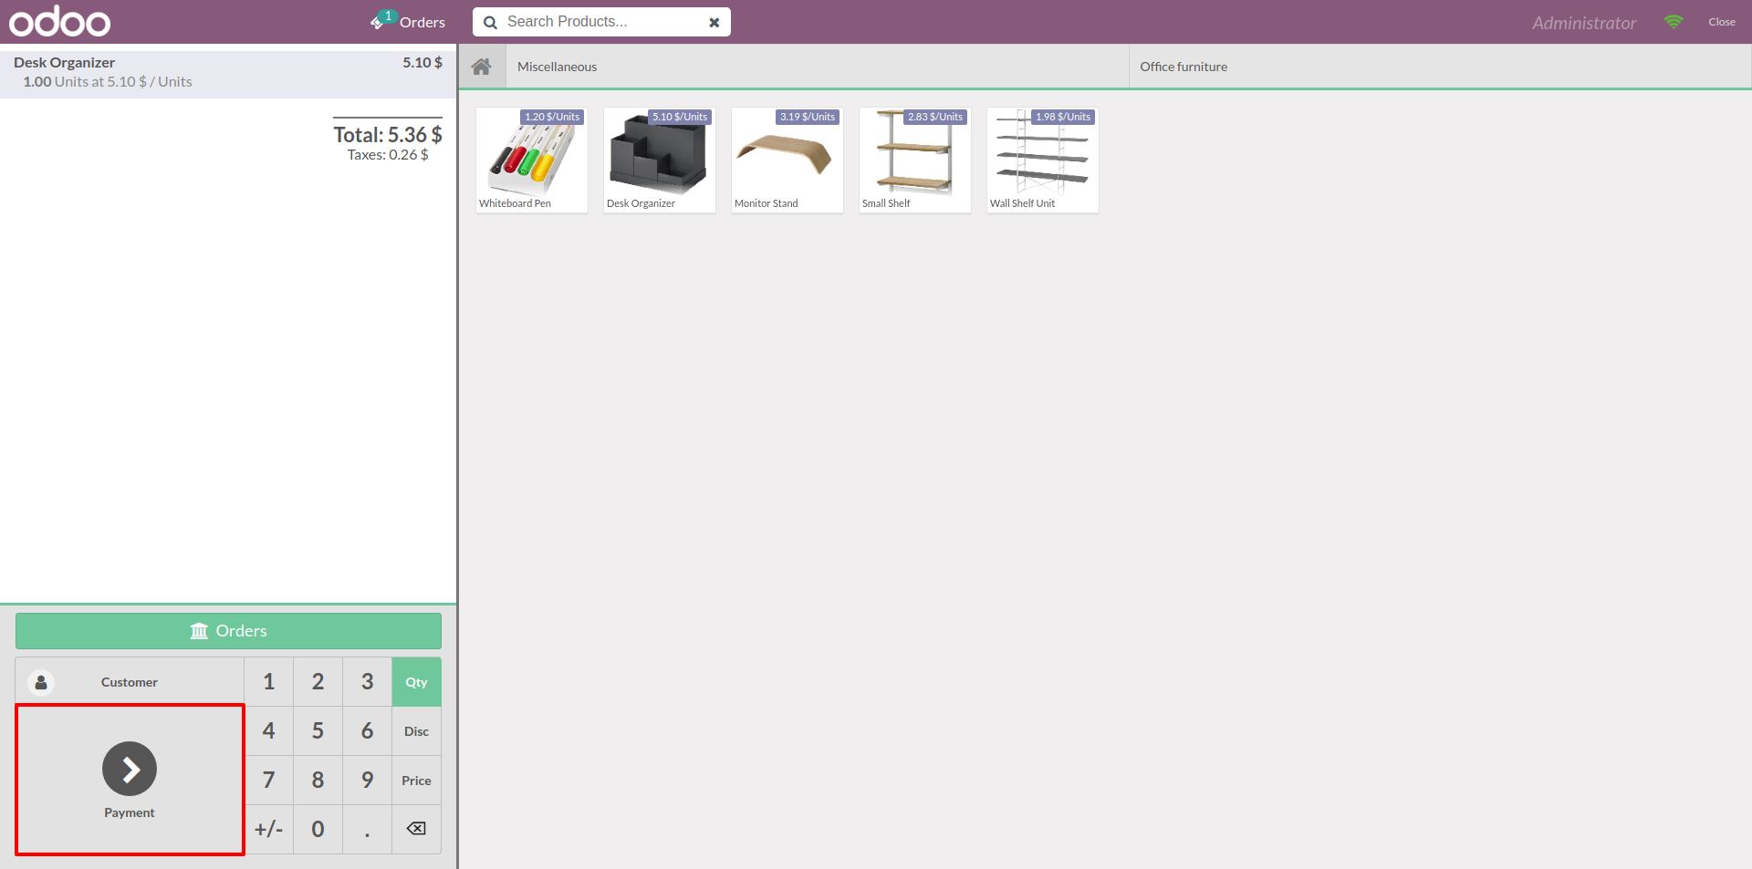
Purchase in Odoo POS…
Now, click on
“ Payment ” tab.

Slide 49
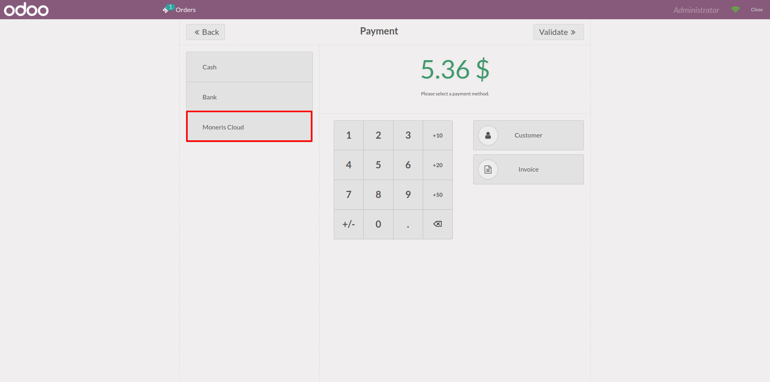
Purchase in Odoo POS …
1. Click on “ Moneris Cloud” for Payment.

Slide 50
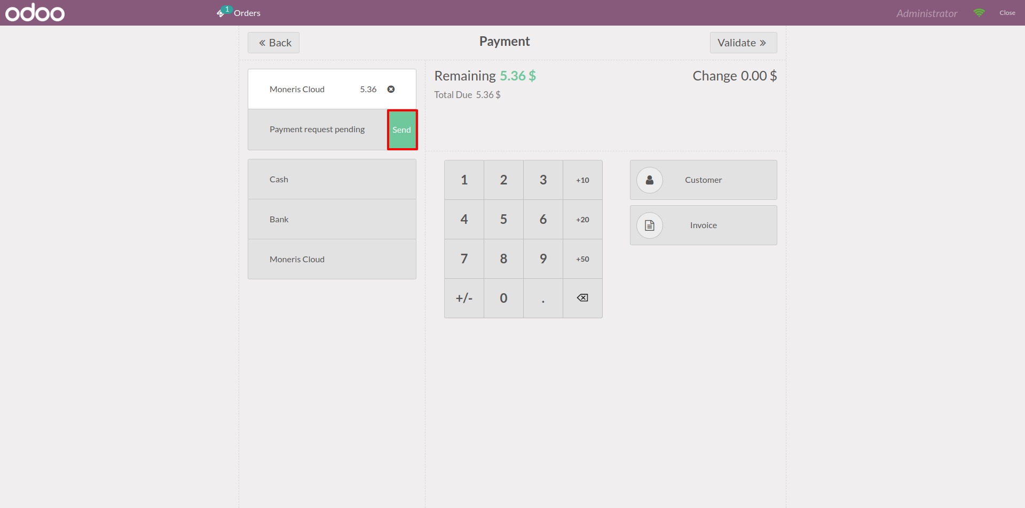
Purchase in Odoo POS…
1. Now Click on “ Payment request pending , Send” button.

Slide 51
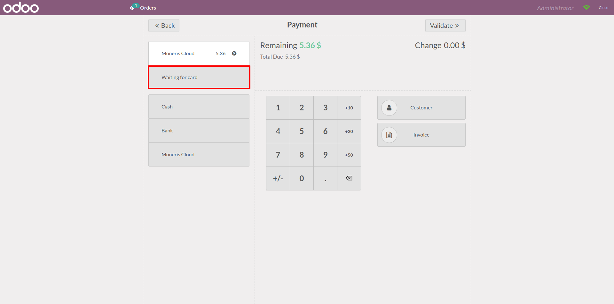
Purchase in Odoo POS…
Status will change from "Payment request Pending" to "Waiting for Card”.
Insert the card in the Moneris Terminal.

Slide 52
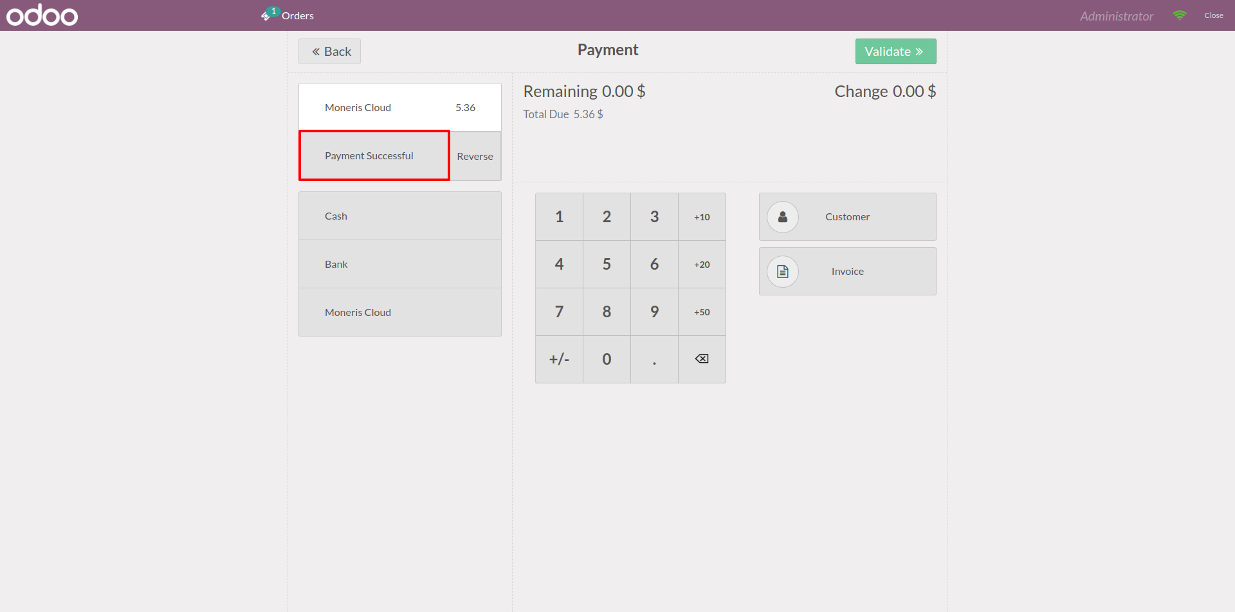
Purchase in Odoo POS…
Insert the card in the Moneris Terminal.
After a successful transection the status will show “Payment Successful”.

Slide 53
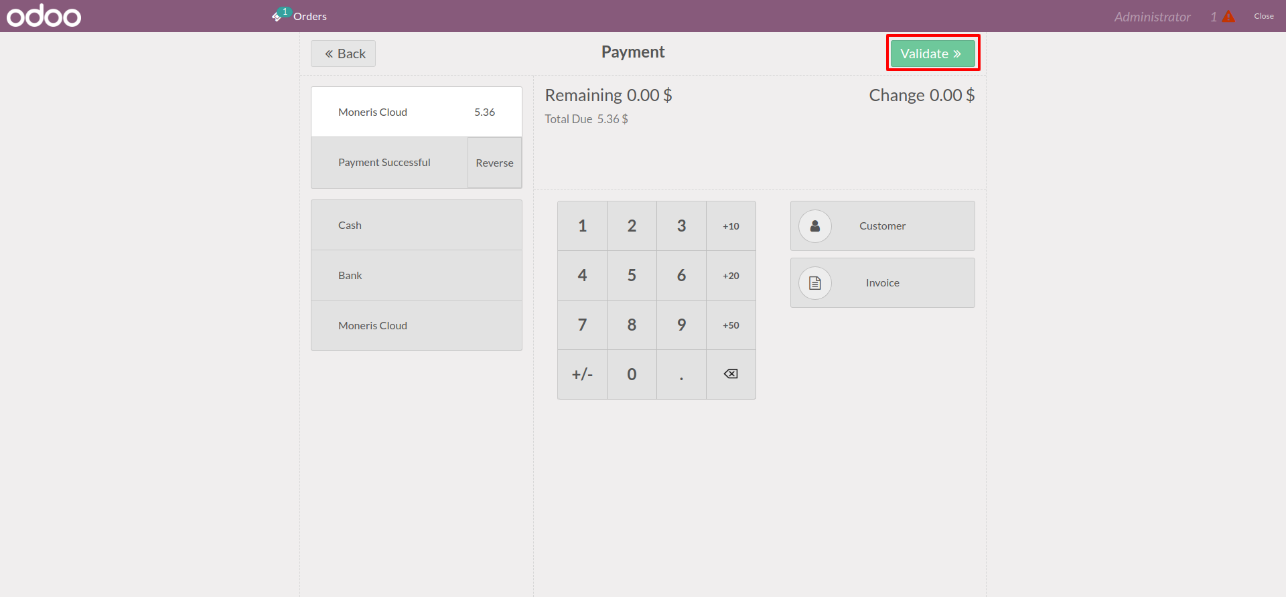
Purchase in Odoo POS…
Now, click on validate button.

Slide 54
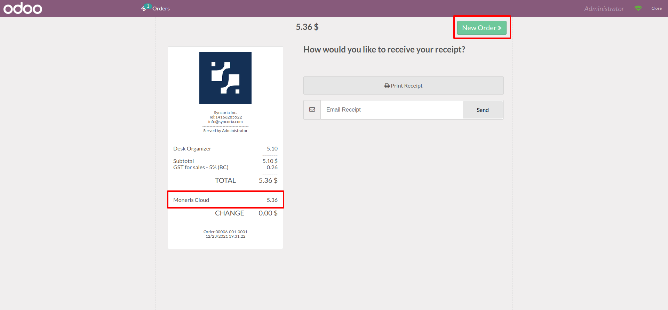
Purchase in Odoo POS…
Here, We can see the receipt.
To create a new purchase order, click on the “New Order” button.

Slide 55
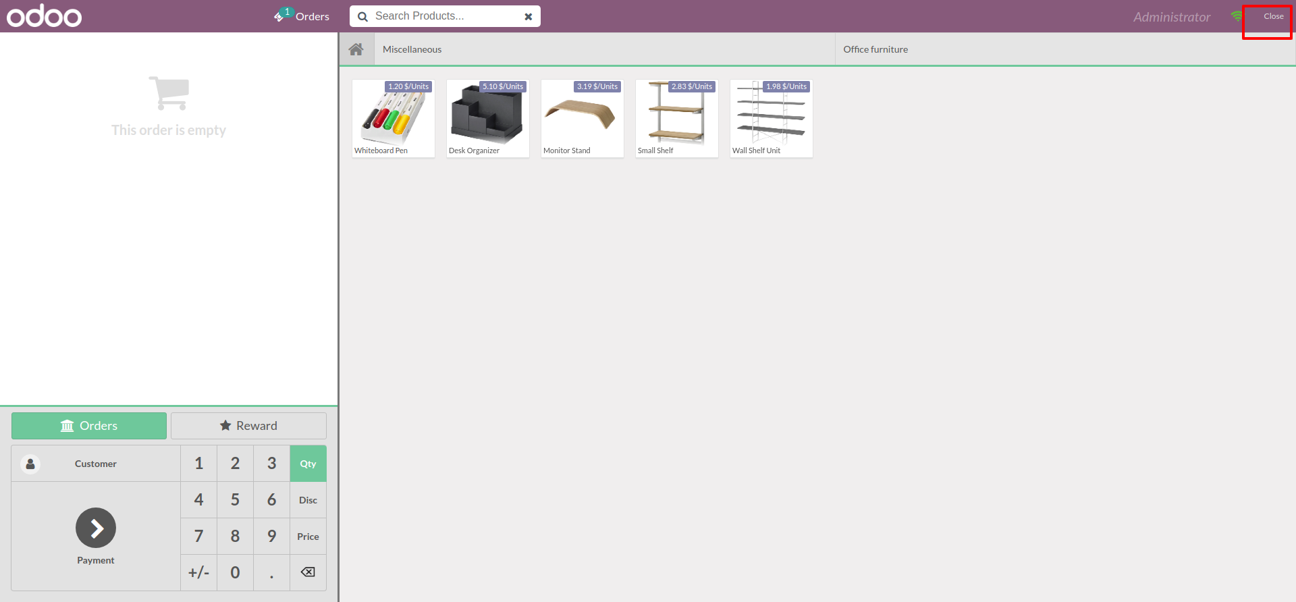
Purchase in Odoo POS…
Now, click on the close button.

Slide 56
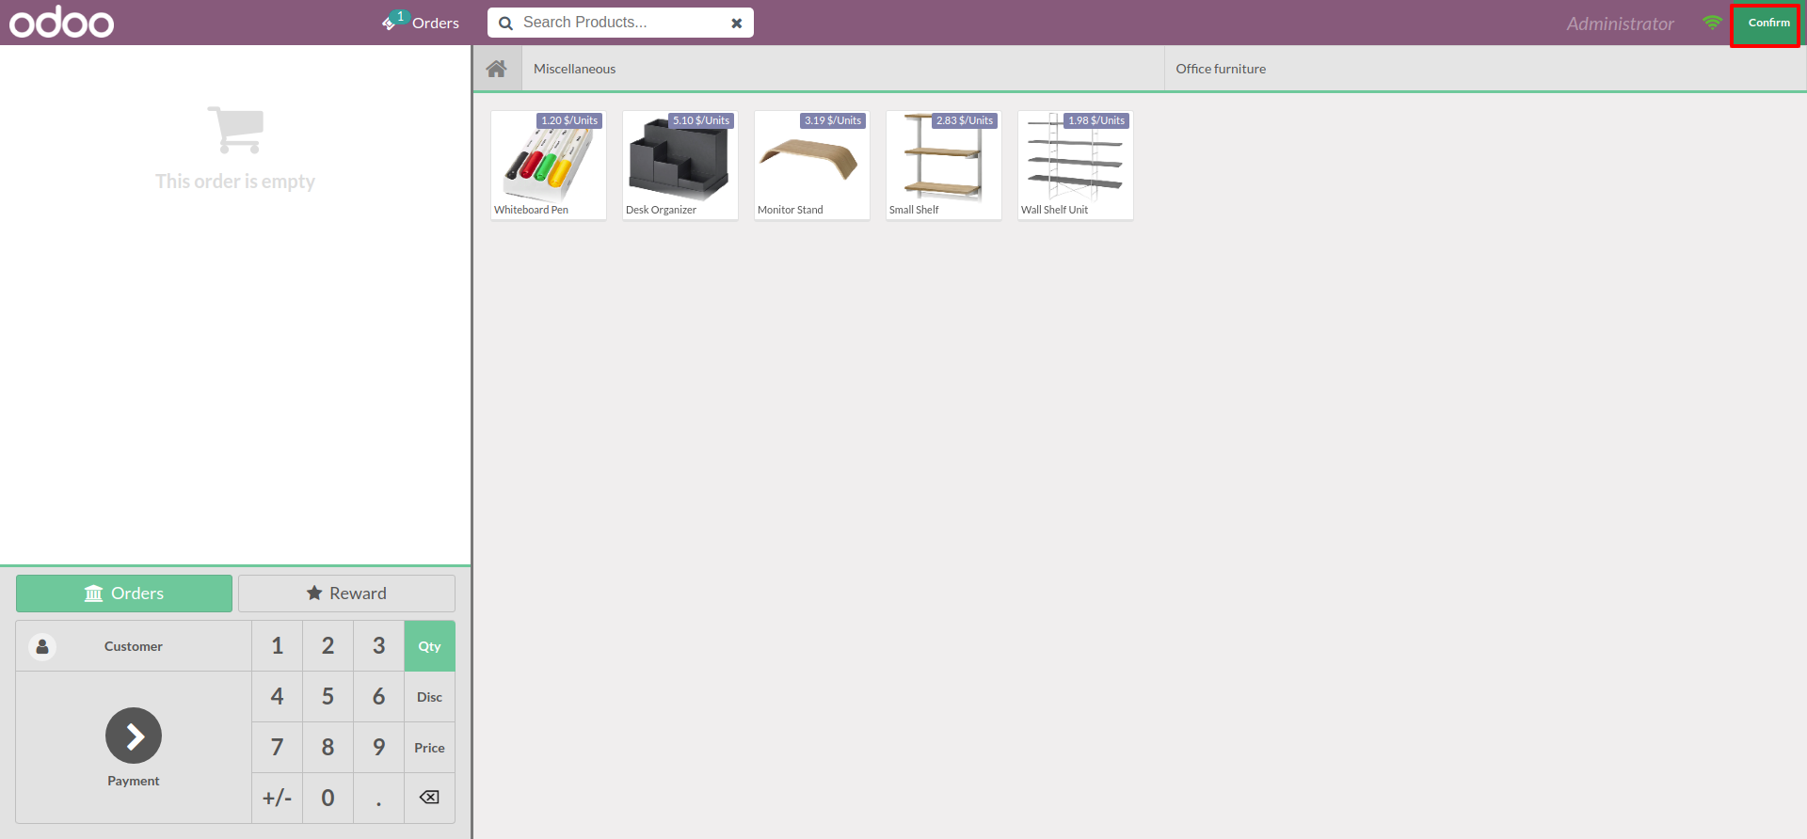
Purchase in Odoo POS…
Now, click on “Confirm” button

Slide 57
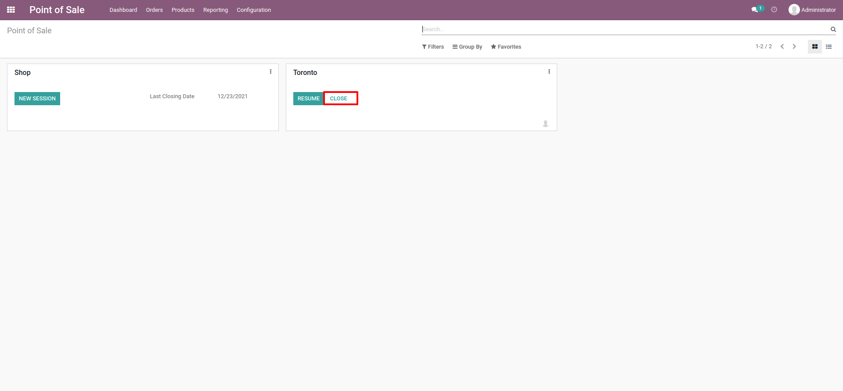
Purchase in Odoo POS…
Now, click on “Close”.

Slide 58
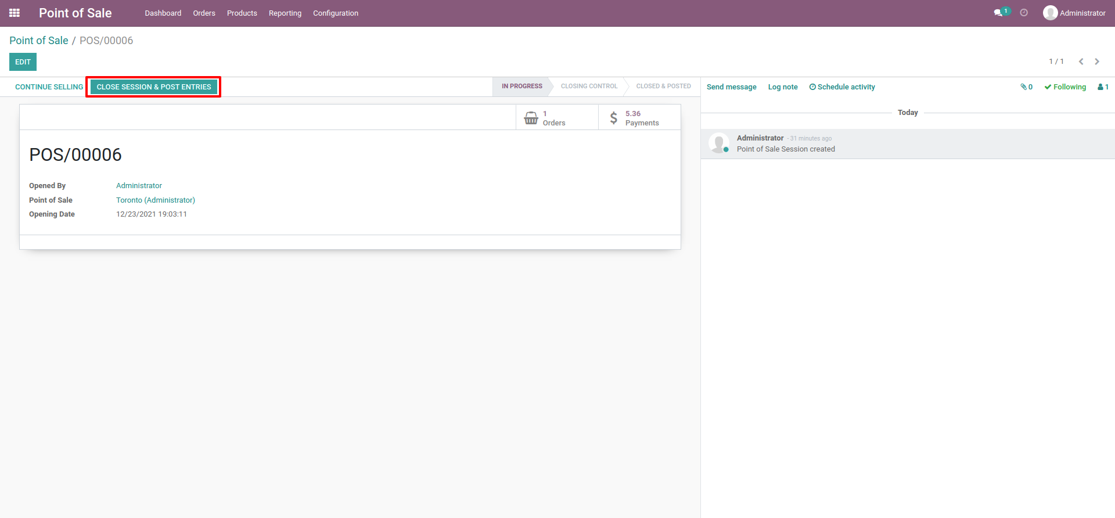
Purchase in Odoo POS…
Now, Click on “Close Session and Post Entries”

Slide 59

Purchase in Odoo POS…
Go back to point of Sales module.
Click on Orders 🡪 Payment.
Now, click on the record.

Slide 60

Purchase in Odoo POS…
Now, click on the record.

Slide 61

Refund in Odoo POS
1. Now, Click on “ Order button”.

Slide 62

Refund in Odoo POS …
1. Now, Click on “ Return Order” Button.
2. Now, Set “ Return Qty” and click on apply.

Slide 63

Refund in Odoo POS …
Now, Set “Return Qty” and click on apply.

Slide 64

Refund in Odoo POS …
Showing the Refund amount details.
Click on the “ Payment” button.

Slide 65

Refund in Odoo POS …
1. Click on the “Moneris Cloud”.

Slide 66

Thank You
Syncoria Inc
1200 Bay St. Suite # 202, Toronto, ON M5R 2A5, Canada
+1416-628-5522
info@syncoria.com
www.syncoria.com

